Slide 1
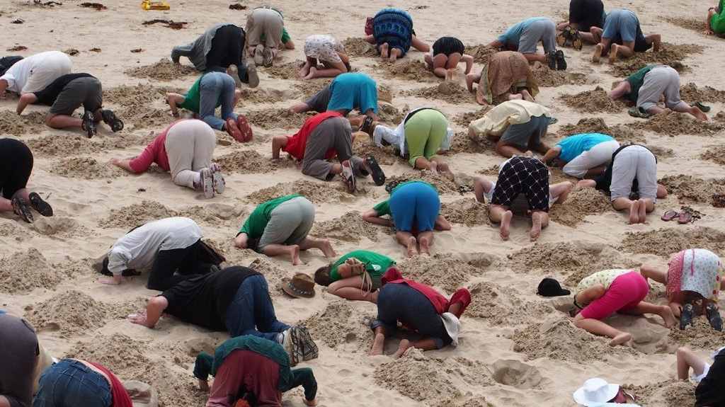
Pulling Our Heads Out of the Sand:
Educating for Today’s Connected World
Thomas Brennan
Assistant Lecturer
Stockholm University of the Arts
Film and Media
Notes:
Thank you for the kind introduction.
The title of my talk today is a bit provocative.
It implies, that like the myth of the ostrich, we as educators can tend to resist the influences, the pressures, the engagement with the wider world around us.
Of course, we are here today from many different nations and school systems, intent on gaining and growing and connecting with one another, to learn and share techniques and strategies as we navigate leadership in these times of conflict.
Today, my interest is in the practical steps we can take to foster an outward looking perspective in our staff and student cohorts.

Slide 2

Why is internationalisation critical for film/media education?
Notes:
Let’s start with some reminders of why this outward looking perspective is so important.

Slide 3
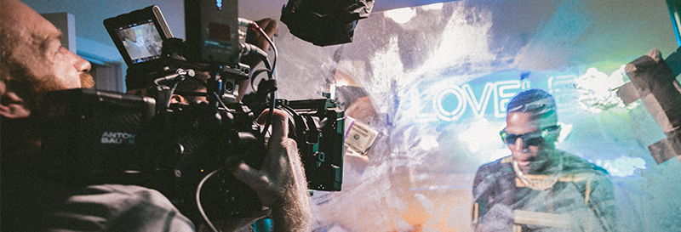
The Global Nature of Film & Media Production
Notes:
The first reminder is about the global nature of film/media productions
Modern film/media projects both large and small often involve international co-productions, with internationally crewed creative and production teams,
along with distribution platforms that cross borders and welcome all levels of production (e.g., Netflix, Amazon, YouTube, TikTok).
Students need to be prepared to work across cultures, time zones, and languages.

Slide 4
Cultural Literacy Enhances Storytelling
Notes:
Rich, nuanced storytelling emerges from understanding diverse perspectives.
Internationalisation helps students explore themes of identity, conflict, power, and belonging—central to all compelling media.

Slide 5

Collaboration Builds Critical Skills
Notes:
This gathering reminds us that
Working with peers from different cultural contexts fosters skills in communication, negotiation, empathy, and adaptability—all vital for future media leaders.

Slide 6
Notes:
Another example is from our own Nordic/Baltic film school association and it is the annual Nord Creative Camp,

Slide 7
Kintai , Lithuania
Notes:
A two week summer camp on the shores of the Lithuanian lagoon.

Slide 8
Notes:
We take the 4 hour bus ride from Vilnius

Slide 9
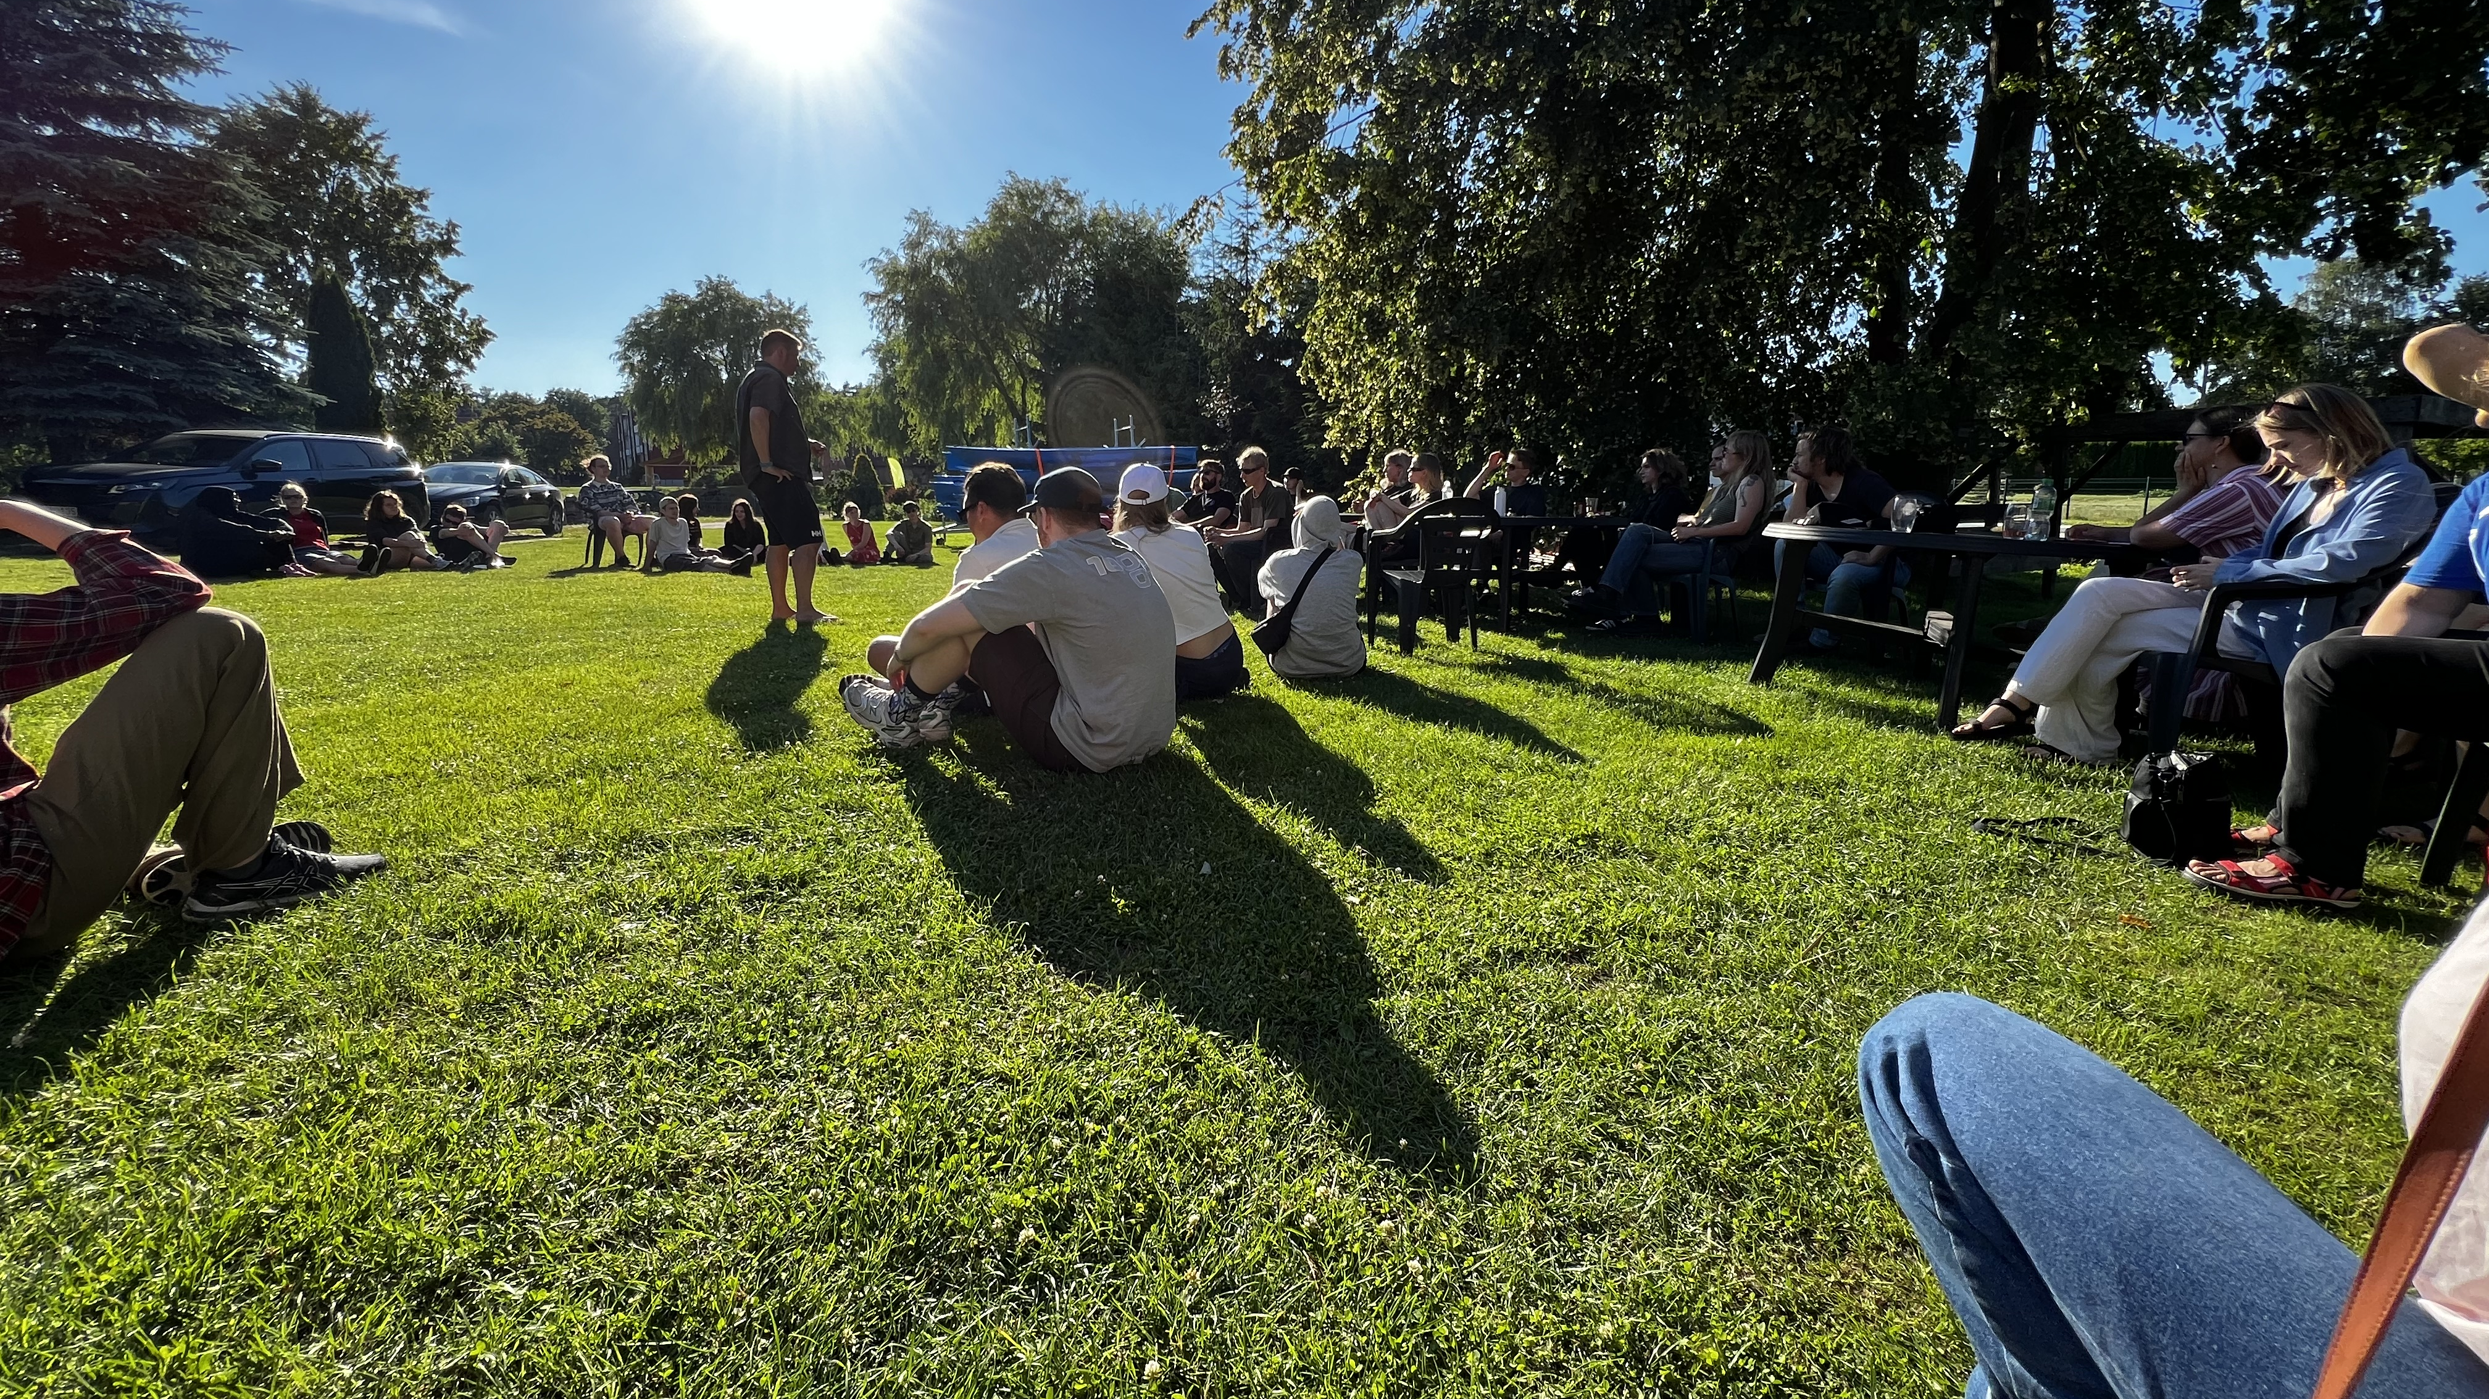
Notes:
44 students from 11 film schools, 5 mentors from member schools, and technical and administrative staff from the National Film School of Lithuania
Gather in Kintai to develop and create a short film.

Slide 10
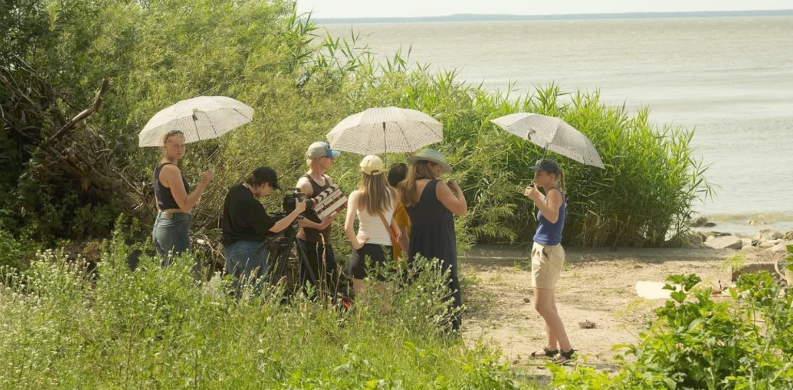
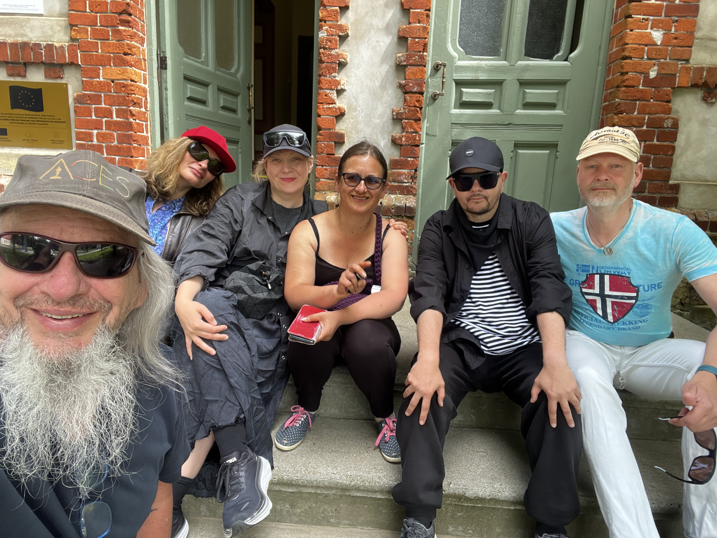
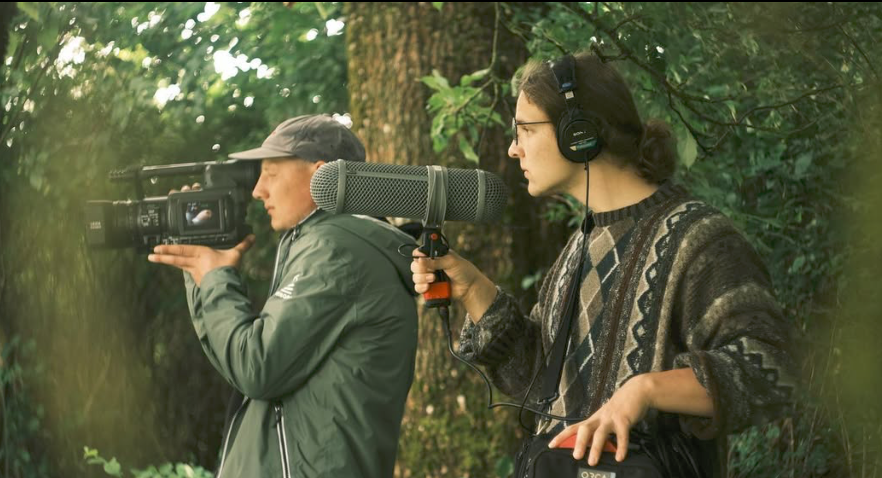
Notes:
Film teams are mixed, mentors work in different pairings with 2-3 film teams. Mentors also deliver a one hour lecture/seminar on this year’s theme, sustainable stories.
And in the evening, the students gather in and around the barn
While the mentors and staff gather nightly in front of the Kintai arts residency
sharing stories of our work, our lives, the crisis-of-the-day sessions, our teaching and mentoring methods, some of which are then brought back to one’s home institution.

Slide 11
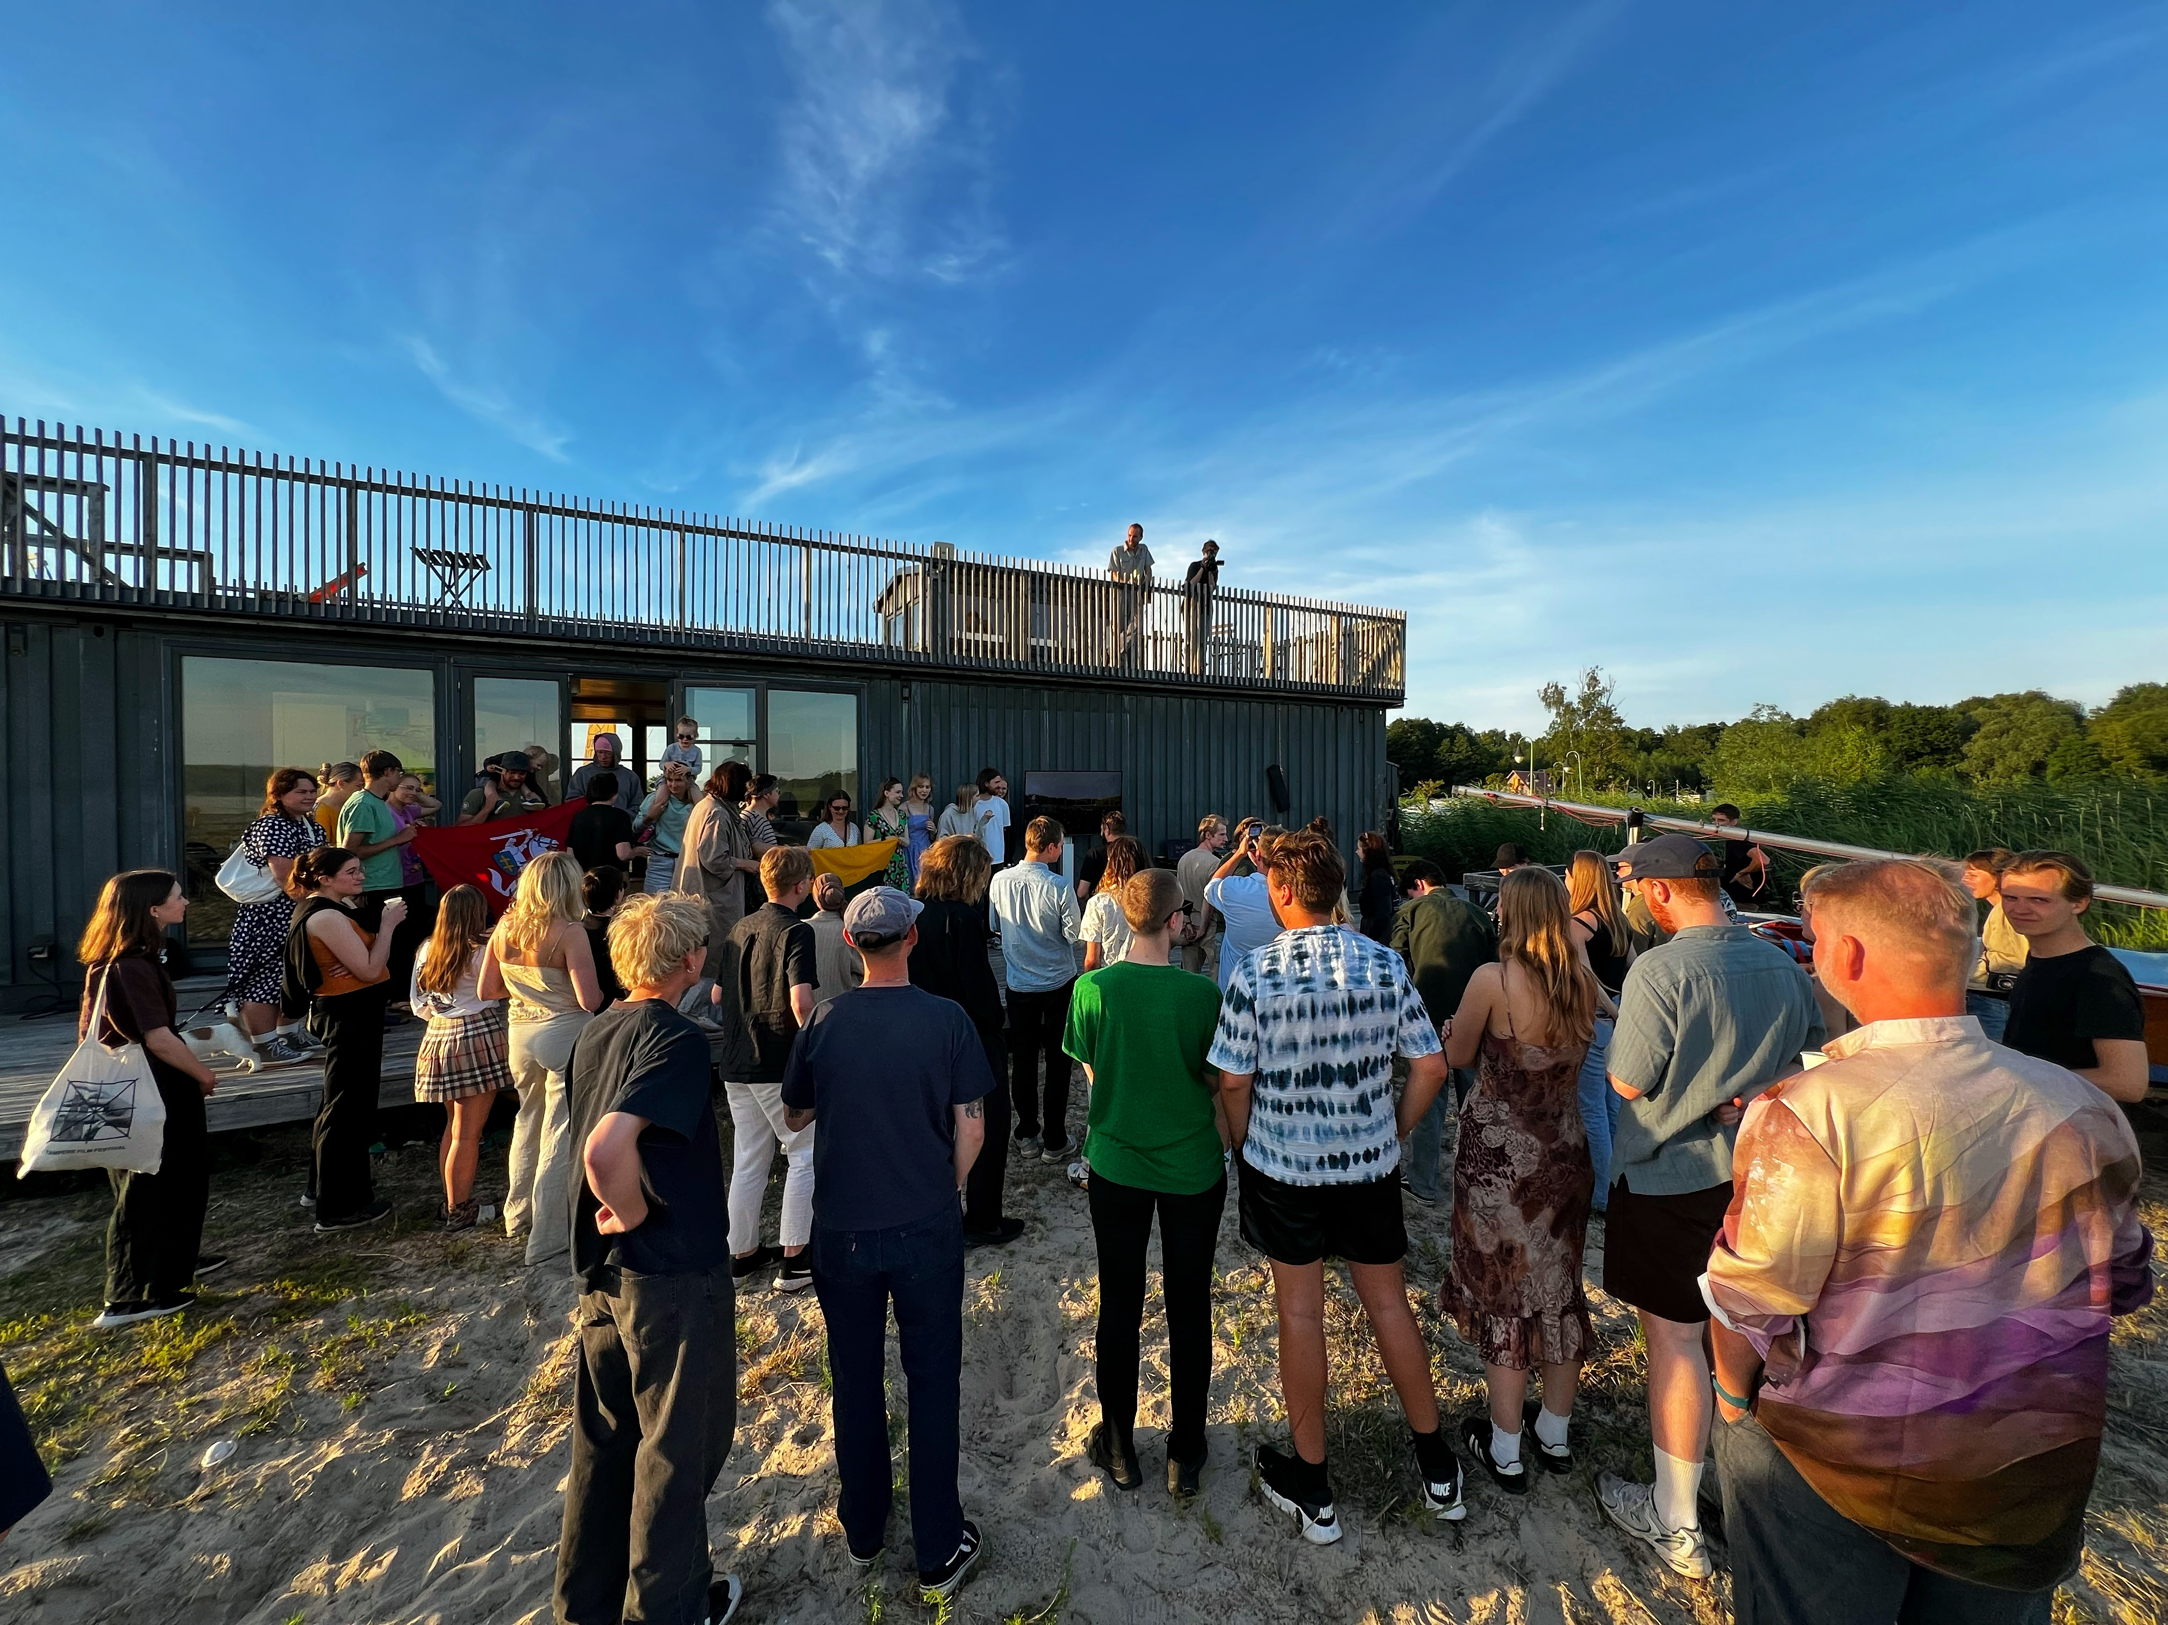
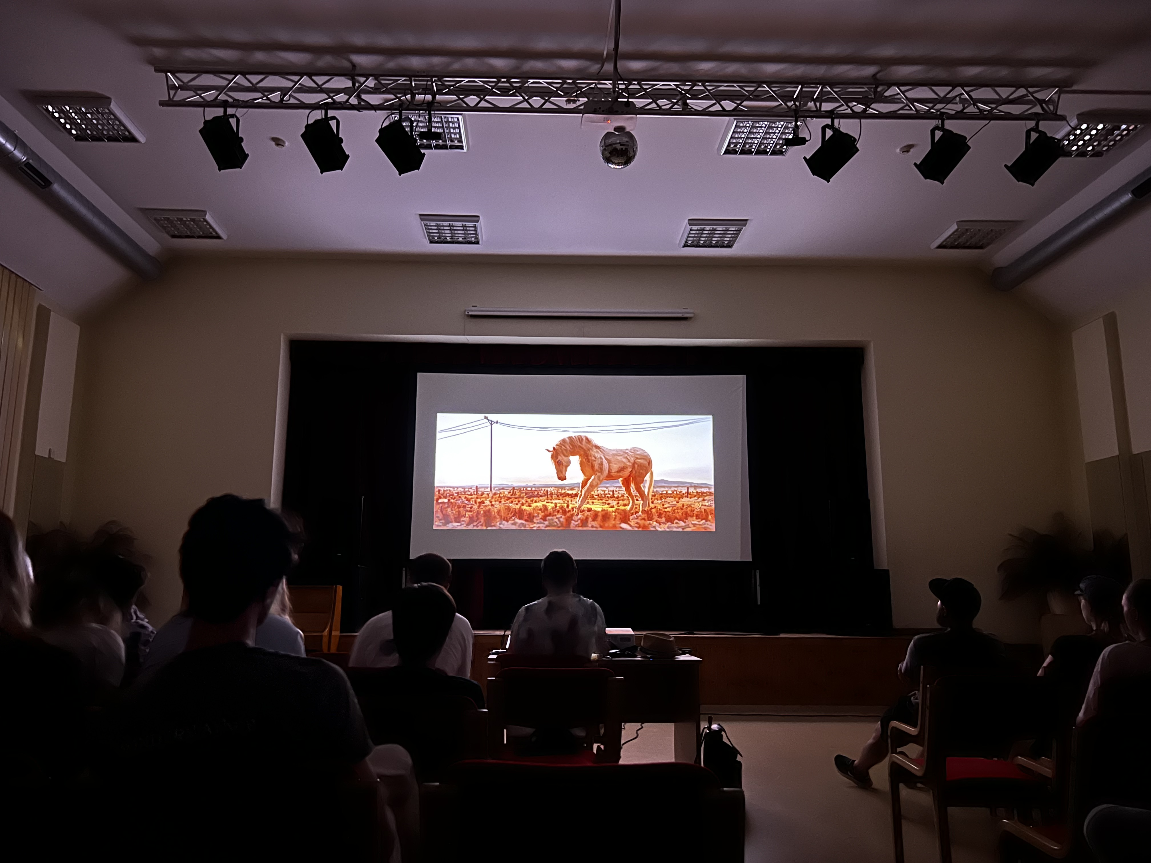
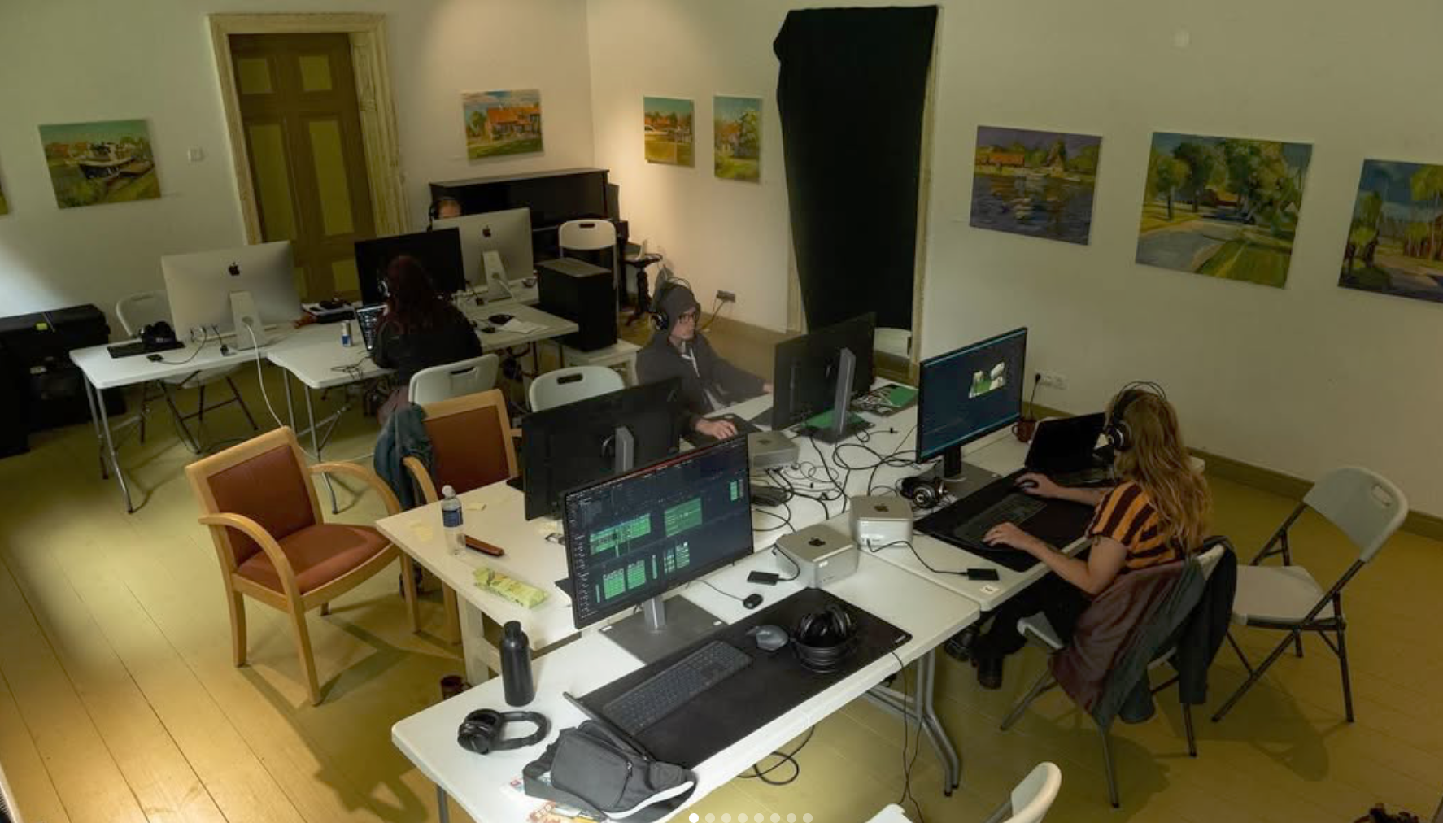
Notes:
During these exchanges,
Students and mentors are exposed to different ways of working and collaborating, deepening their own personal perspectives, as well as embodying their understanding of filmmaking from an international perpsective.

Slide 12

Equity, Access & Voice
Notes:
We are aware of the recent pushback against these seemingly reasonable concepts.
Film/media institutions have a responsibility to recognize and amplify underrepresented voices and support global dialogues.
Sharing these voices ensures that a wider range of narratives are legitimised in academic and industry spaces.

Slide 13

Employability in a Global Marketplace
Notes:
Internationalised graduates are more competitive in roles across production, animation, content strategy, and more.
Cross-cultural competence is now a standard expectation in job descriptions.
And perhaps in our admissions??

Slide 14

Innovation Through Diverse Lenses
Notes:
An international classroom becomes a laboratory for new forms of storytelling and artistic expression.
Creative innovation happens as a necessity at the intersections of different cultures, languages, and experiences.
((End of reasons for international perspectives))

Slide 15
Notes:
Ok, so I just offered some reminders of why this outward looking perspective is so important.
Let’s now think about implementing these perspectives.
Let’s do this with an understanding that these efforts are coming from a leadership perpsective.
Your teaching teams and staff will also have had their ideas about international engagement.
Students and prospective students are also bringing their unique set of expectations to the discussion.
So…

Slide 16

Implementing Internationalisation in Media Arts Education
Where do we start?
Notes:
How do we implement these strategies?

Slide 17

Strategic Plan
Notes:
In order to anchor our internationalization efforts
we can start with the overall strategic plan of our institutions.
These plans are essentilally idealized roadmaps
By stating that internationalization is a key component of your future, your subject heads now have a mandate to implement structures and practices that will lead to international engagement.

Slide 18

Notes:
Starting with the overall vision, we announce ourselves as an international university.

Slide 19

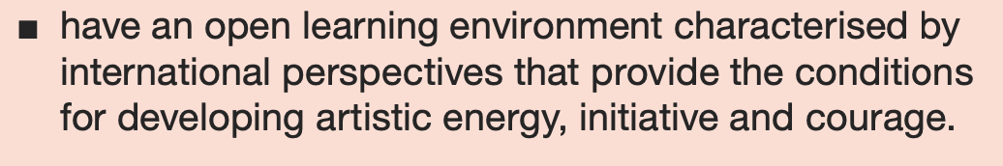
Education
Notes:
We announce our internationalisation as a pedagogic intention

Slide 20

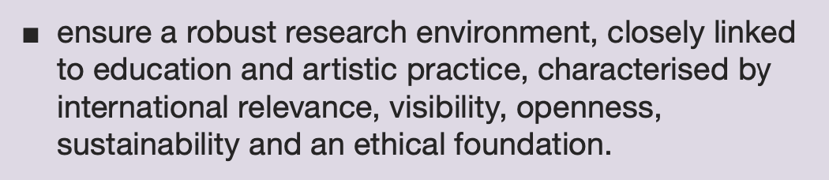
Artistic Research
Notes:
Situatiing your artistic research efforts within the field means you must consider researchers and topics that originate and exist outside of your borders.

Slide 21

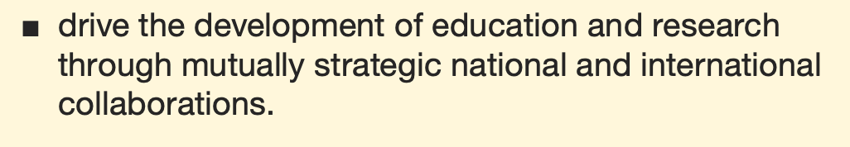
Engaging with Society
Notes:
Engagement with the society around you includes an international component.

Slide 22

Operational plan
Vision
SKH shall be an international leading arts university where arts education and research creates the conditions where art is dynamic, challenging and unbound.
Notes:
Within each subject area, an operational plan should also address and reinforce the strategic plan.
While the strategic plan announces the vision, the operational plan outines the steps that must be taken to achieve the goal.’
These are the visions of a globally connected film/media program.
What are some of these visionary steps we can take in our own institutions?

Slide 23

Course plan
Film Editing III
Learning outcomes:
“Students shall be able to reflect critically about film composition and dramaturgy from various international perspectives”
Notes:
We can start with our course plans.
It could be part of the teaching method-
Film editors take local field and studio visits to Swedish choreographers, visiting Egyptian painters and Venezuelan composers, exposing them to how editing is done in other artistic practices, or through common compositional methods.
It could be a learning outcome-
Students shall be able to speak of their artistic practice in an international context.
It could be part of the course materials:
Textbooks, films, exhibitions, performances

Slide 24

Embracing Global Perspectives in our classrooms
Notes:
At the classroom level, The plan is to prepare students to thrive in an interconnected world.

Slide 25

Insist on a Globally Oriented Curriculum
Notes:
Each course, each cohort, each teacher will engage with the world in different ways and at different levels.
The point for leadership is to make the world available.
Integrate international case studies, global storytelling traditions, and cross-cultural media analysis.
Encourage relevant class trips abroad (a festival, conference, or a workshop)
Invite international visitors (live and zoom)
Encourage and help curate individual student interest in the world.
For the teaching team, during idividual discussions about the yearly work plan, include internationalization hours.

Slide 26

Storytelling as a Global Bridge
Notes:
By encouraging students to engage with global narratives and diverse perspectives, educators can cultivate filmmakers who will have a better
Understanding of the universal and transformative power of stories in addressing societal challenges.
In color grading master classes, students work in groups to create a film look based on the color schemes they discovered researching a particular country’s use of color in feature films.

Slide 27

Promote Multilingual Storytelling
Notes:
Most of our students are already, at a minimum,, bilingual when they arrive to us.
We should encourage them to create films in multiple languages and explore translation and subtitling as creative tools.

Slide 28

Foster a Multilingual and Inclusive Environment
Notes:
Encourage faculty to incorporate diverse languages and cultural contexts in their teaching to make courses more globally relevant.
Support (financially, adminstratively, emotionally) international professional development for all staff, or require it at some agreeable level (one cross border: conference, workshop, teacher exchange,…)

Slide 29


Leadership Resilience Amid Political and Societal Change
Notes:
We also need to start with a good supply of resilience.‘
Keep in mind that our
Advocacy for global engagement ensures institutions remain adaptable and forward-thinking.
We need to nurture our efforts, give them the attention they need to survive and grow.
This is the day-to-day.

Slide 30

Establish International Partnerships
Notes:
The simplest way to engage with the world is to invite them over for lunch.
Form alliances with other film schools, production companies, and media organizations to facilitate student and faculty exchanges.
Those of us in the Nordic region now have two strong regional associations within which we collaborate regularly.
I would like to hear from other GEECT members who have regional film school associations.
Another question- which schools belong to an association of film schools other than GEECT or CILECT?
Those of you who do not, seriously consider that idea, reach out to those film/media programs nearest you. Start a dialogue. Apply for funding.

Slide 31

Enhance Student Mobility Programs
Notes:
While there is quite positive value in teacher exchanges,
we should continue to inspire and create opportunities for students to study or workshop abroad, participate in regional and global film festivals, and engage in international production projects.
Make mobility the norm and not the exception.
Enhance can also mean to interlock, with one another’s programs, to offer areas or topics that other schools may need to deepen their students’ learning.

Slide 32

Harnessing Technology for Internationalisation
Notes:
Institutions can leverage these collaborations by using the available virtual tools and digital storytelling platforms,
to integrate internationalisation without relying on physical travel, ensuring accessibility and inclusivity.

Slide 33

Use Technology to Bridge Borders
Notes:
Promote virtual exchange programs, online collaborative projects, and co-teaching with international faculty through digital platforms.
I urge you to discuss with someone here today how your two institutions could share a virtual classroom if only for a few hours.

Slide 34
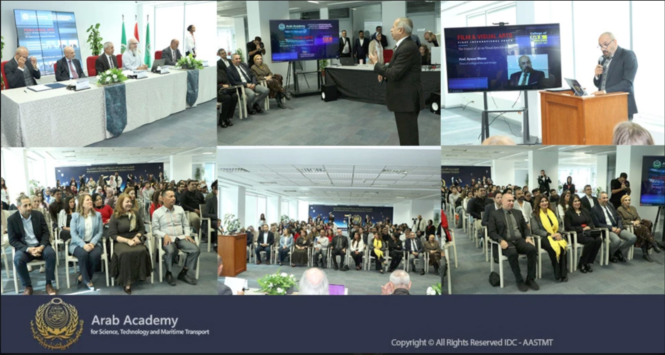
1st International Forum for the Influence of AI on Art Education
Notes:
These particular photos show an AI in Film Education forum I helped organize with our Erasmus ICM partner in Cairo.
Our students in Sweden participated via Zoom with the students and faculty from the Arab Academy’s College of Art and Design at their Smart Village campus.

Slide 35
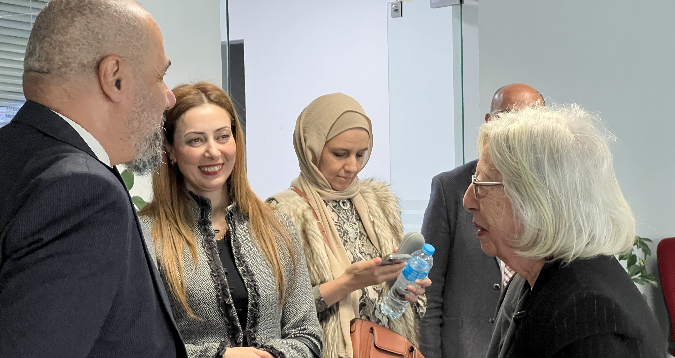
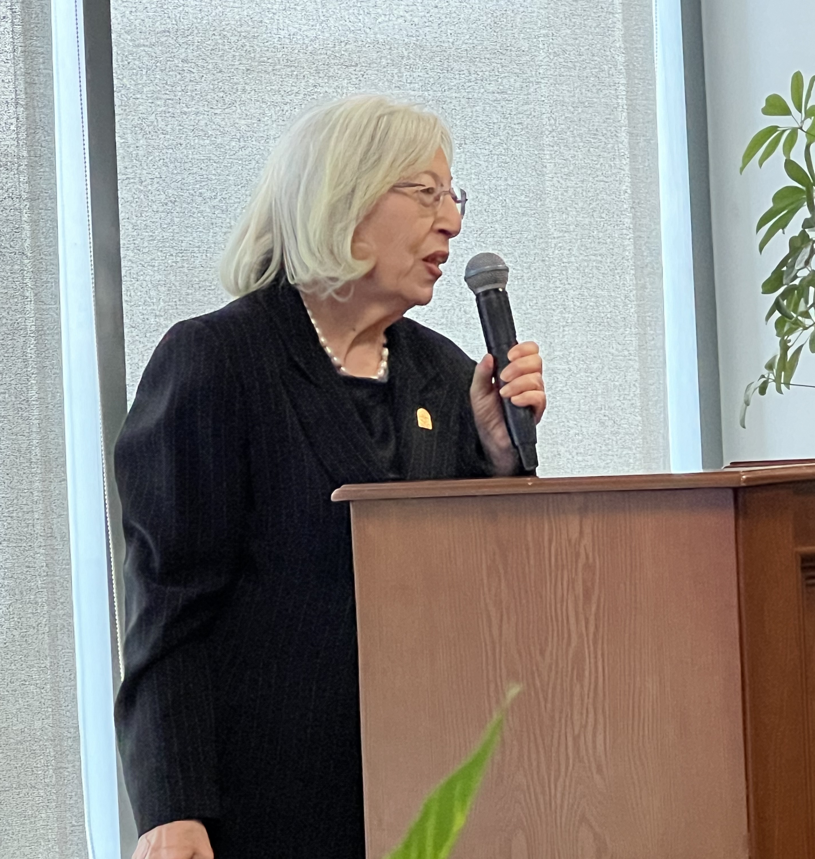
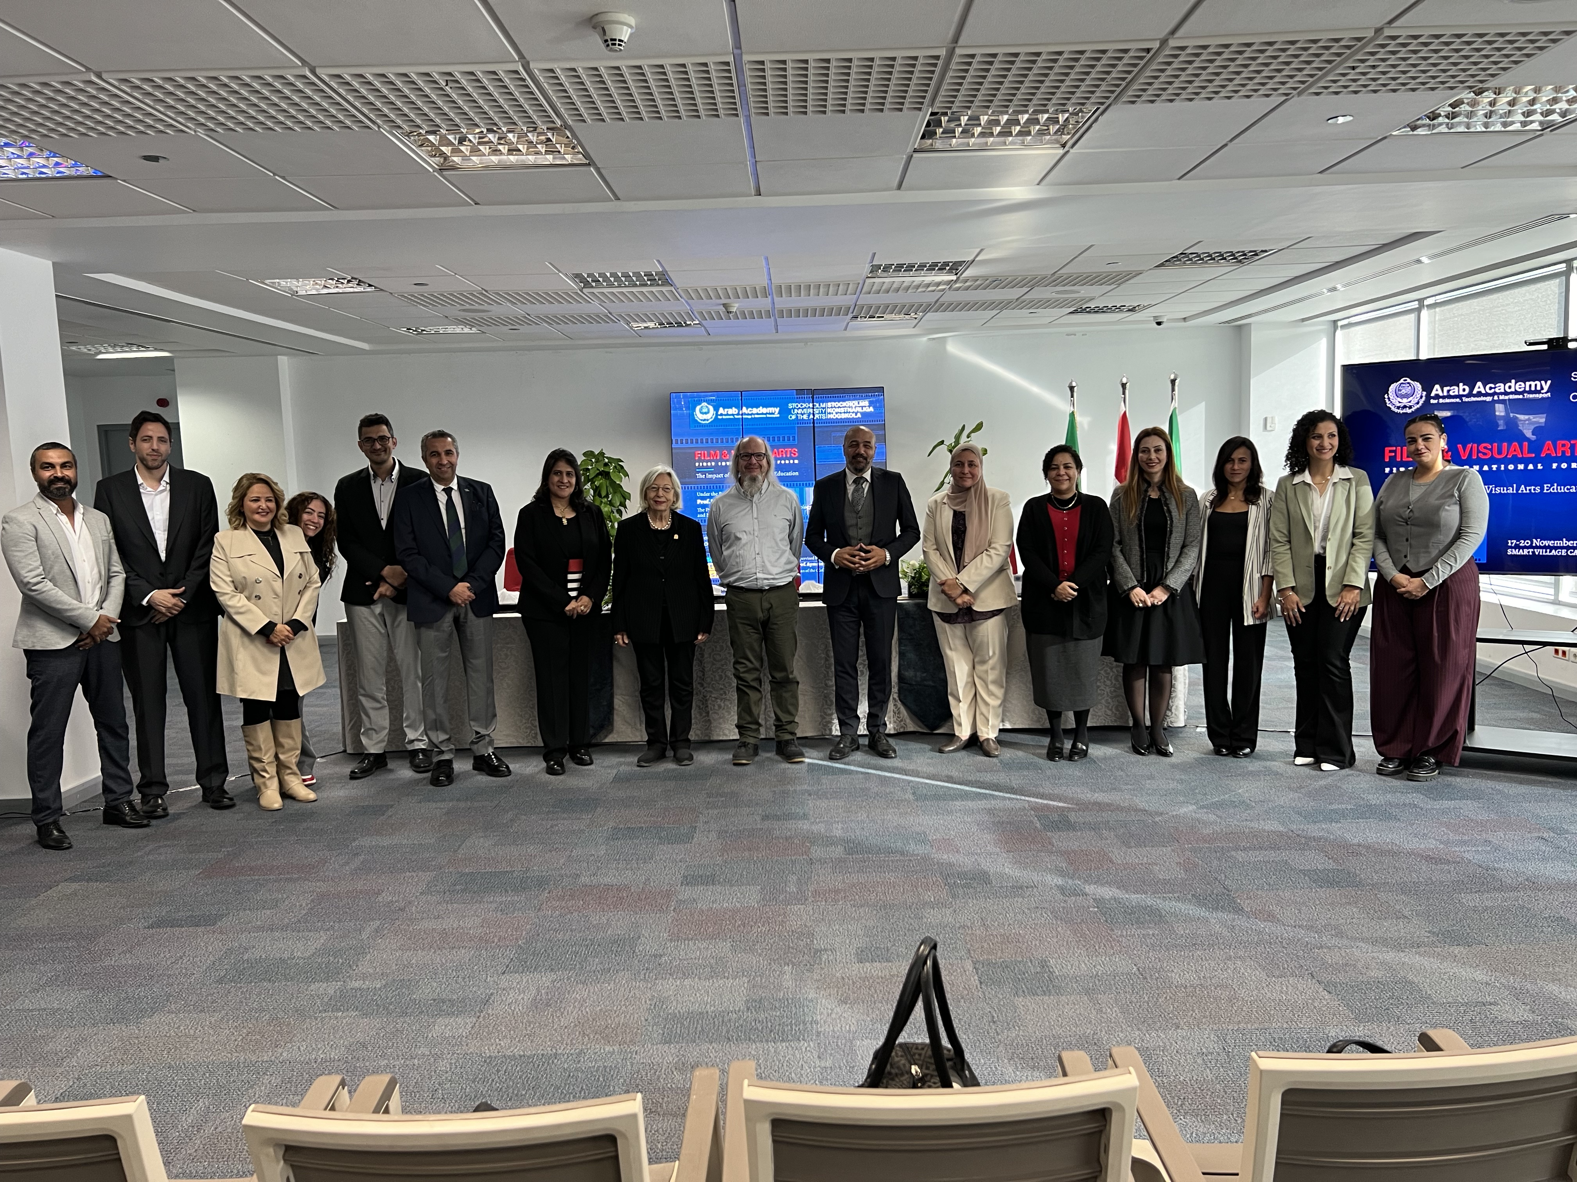
Notes:
This three day forum included presentations from Arab Academy professors from the visual arts, film, architecture, fashion, communications and AI colleges. Egyptian filmmakers, production designers, and trans media artists presented their work and reflected on how AI has seeped into their work and work processes.
Panel topics covered ethics, authorship, and AI’s impact on the classroom and creativity.

Slide 36
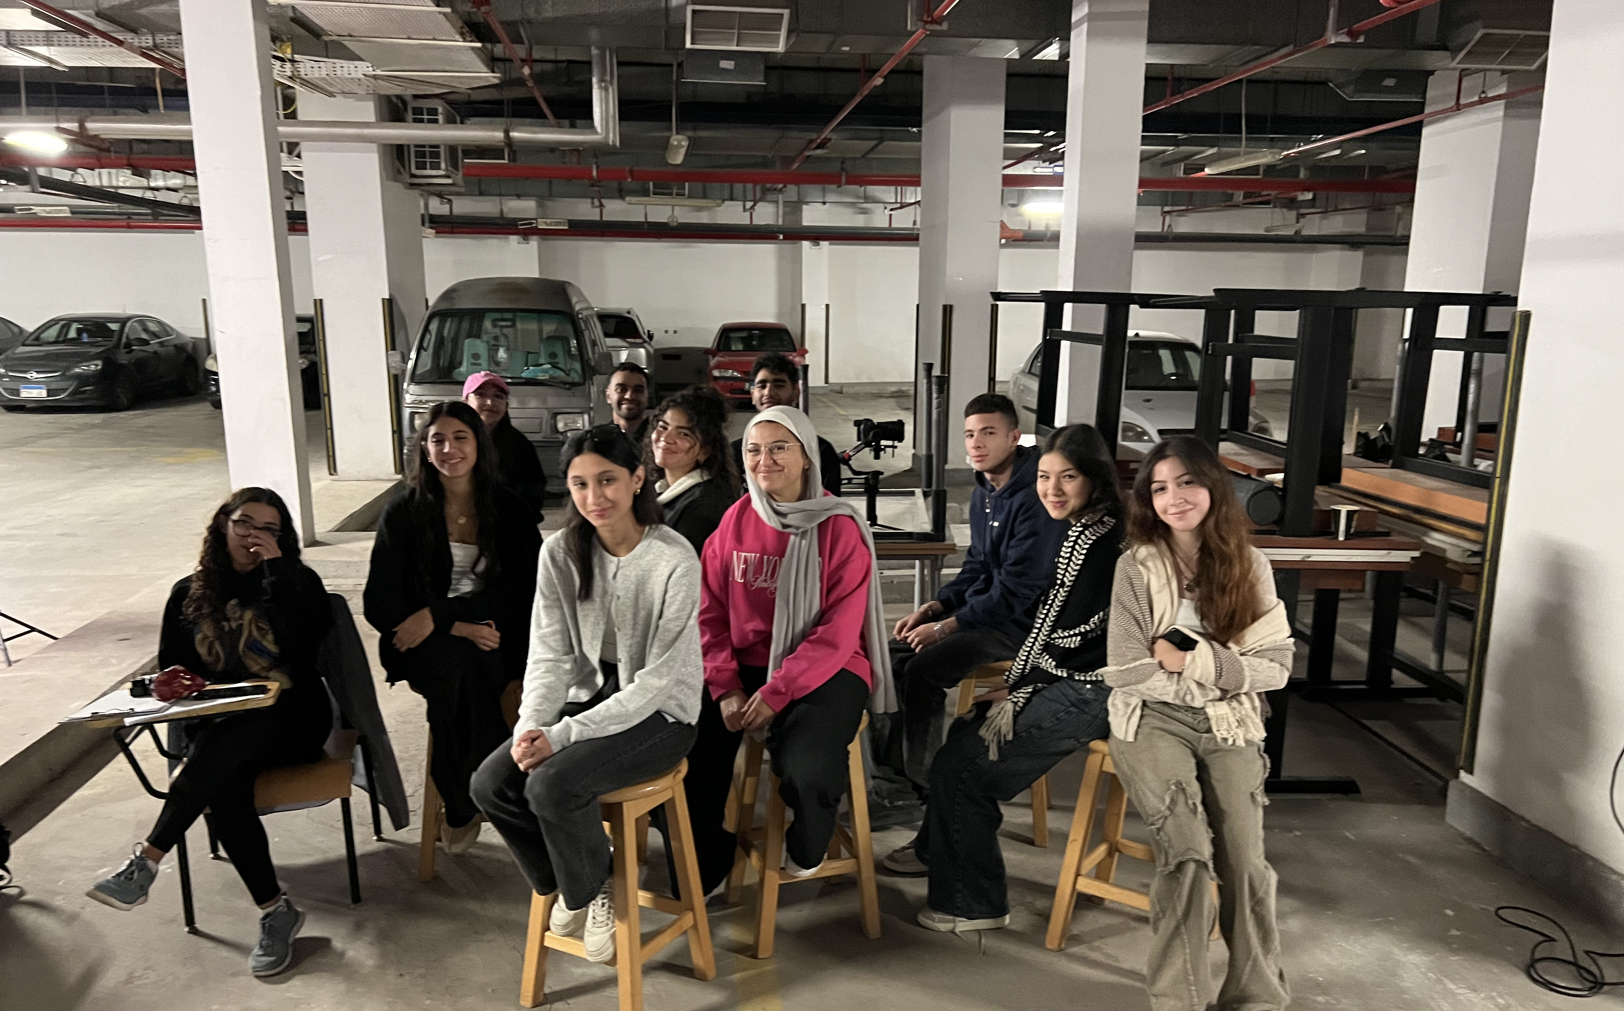
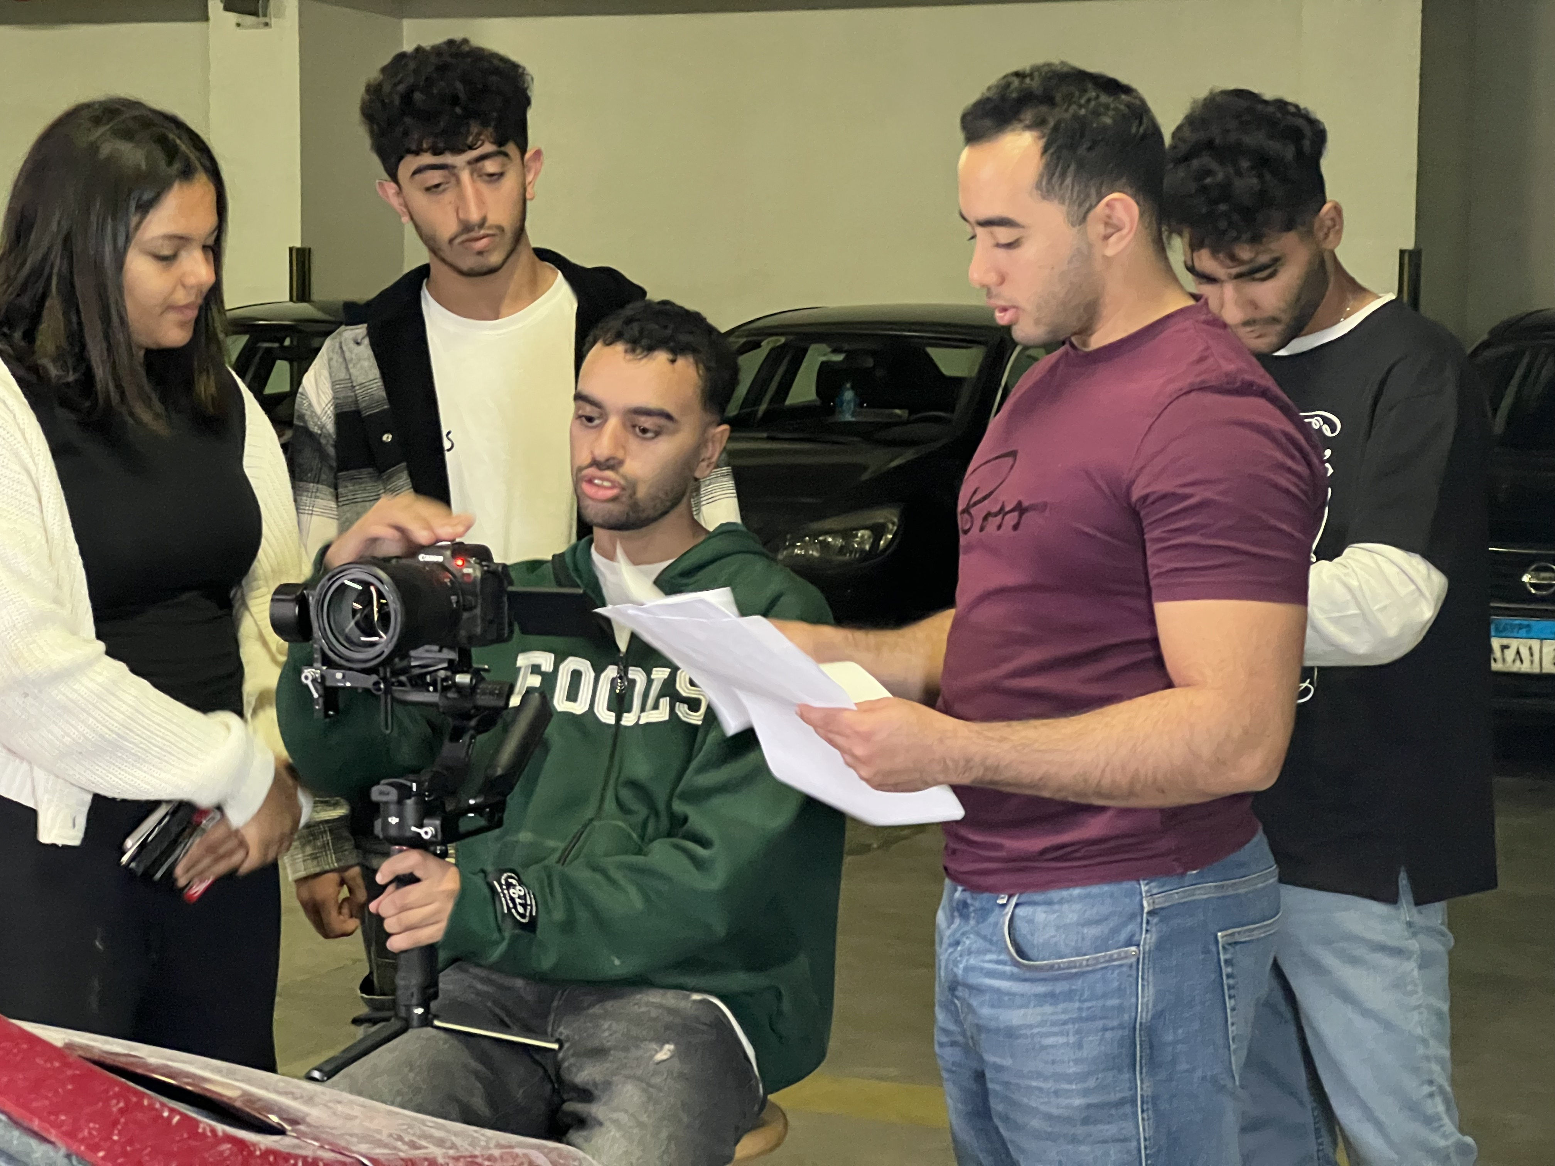
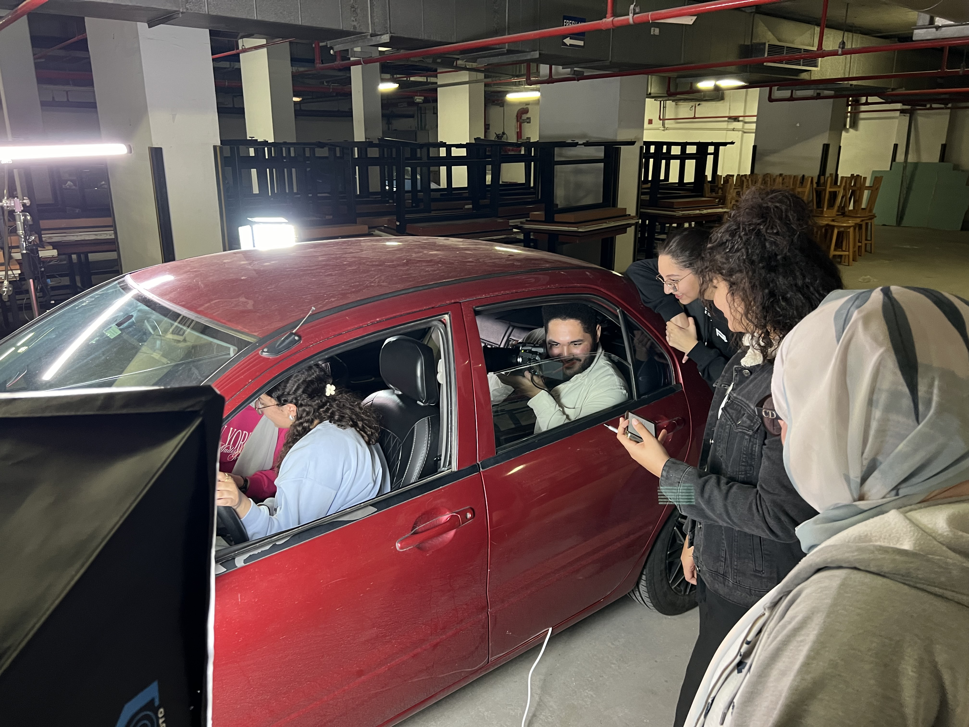
Production Exercise
We gathered the 2nd year film students down into the underground parking garage. It was actually raining in Cairo that morning, so our cars-on-a-street production moved indoors.
Notes:
… and the hope is to develop more of these opportunities with other university film programs both here, in Europe, and around the world.
And while we use online platforms to connect students and faculty across borders for joint film projects and workshops,
We also may need to review our pedagogic guidelines for online/virtual classrooms.
And to Seek More connectivity funding.

Slide 37
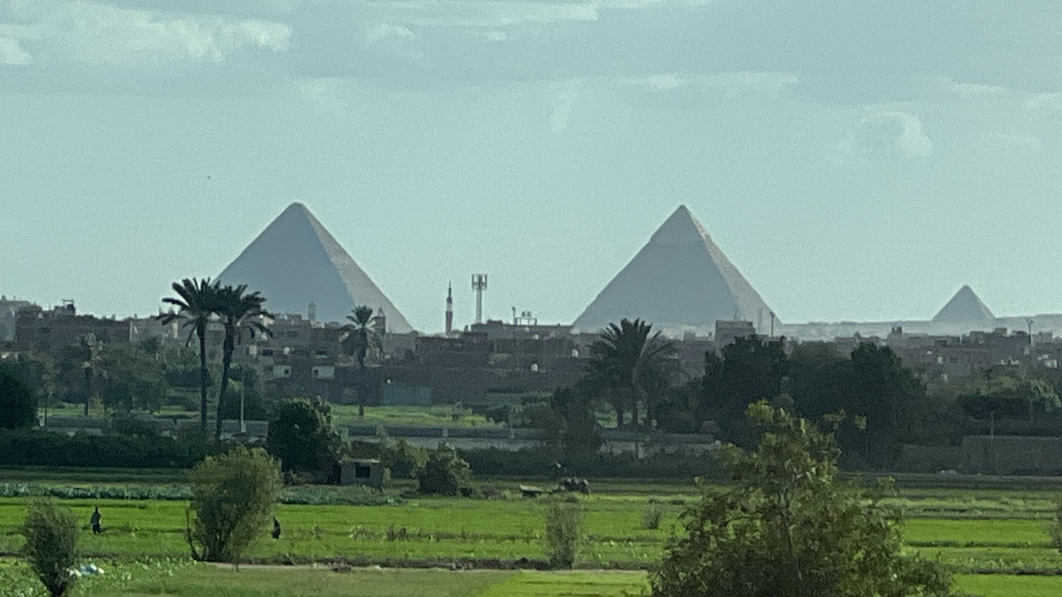
Notes:
One of the more surreal aspects of any exchange experience is the view on the way to and from work.

Slide 38

Creative Problem-Solving Through Artistic Leadership
Notes:
So, We can also start to
Encourage interdisciplinary and experimental approaches in order to allow teaching teams to address challenges with fresh perspectives and collaborative solutions.
Develop a working group on internationalisation for teachers, administrators and students to help define realistic internationalisation goals, goals which consider the adminstrative time and costs, the program’s visitor capacity, a .proper vetting of potential partnerships

Slide 39

Diversify Faculty and Guest Lecturers
Notes:
Invite international filmmakers, media scholars, and industry professionals to contribute to the learning experience.
(Contact your nearest international film festival to see who will be in town)

Slide 40

Integrating Ethical Practices in a Globalised Film Industry
Notes:
Leaders can emphasise the importance of cultural sensitivity, equitable representation, and responsible practices in storytelling and production,
ensuring students are prepared to navigate the complexities of international collaborations.
Bringing in a workshop leader for a day is a way to start the converstaions around these issues.

Slide 41

Address Global Challenges Through Film
Notes:
All of our courses, regardless of specialization, should have sections where student skills are used to explore current social and environmental challenges.

Slide 42

Overcoming Language Barriers in International Film Education
Notes:
Storytelling is a universal language that can transcend words, allowing students and educators to connect through shared artistic expression.
By promoting patience, active listening, and cultural sensitivity, our programs can transform language barriers into opportunities for deeper understanding and innovation in film education.
One can foresee the power of AI assisted real-time language translation. Make use of these tools to expand teacher and student exposure to and development of the relevant stories of our time.

Slide 43


Slide 44
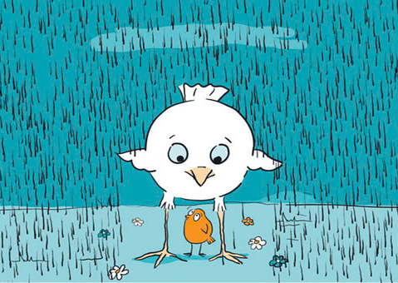
How do we inspire our teaching teams?
Notes:
So moving beyond the discussion of how we might implement an internationalist approach in our programs,
The question rremains, how do we inspire our teaching teams?

Slide 45

Lead by Example
Notes:
Your being here today is an example of a way to grow your international awareness and presence
Demonstrate a commitment to world engagement through your own research, collaborations, and curriculum innovations.

Slide 46
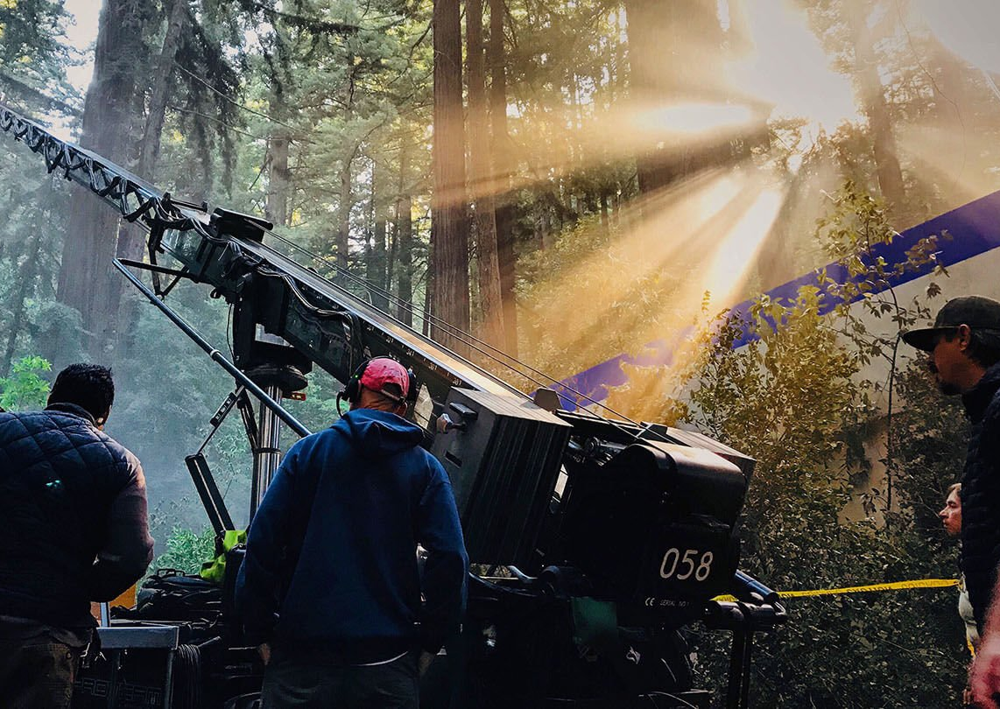
Highlight Industry Demands
Notes:
Show how the global film and media landscape requires students to be internationally competent.
Bringing in guest speakers, alumni, or industry professionals with international experience who can illustrate the career advantages of global engagement.

Slide 47

Invite international educators to visit
Notes:
In addition to encouraging teachers to engage internationally,
Bring in guest speakers, alumni, or industry professionals with international experience who can illustrate the career advantages of global engagement.
Use that Erasmus funding!

Slide 48
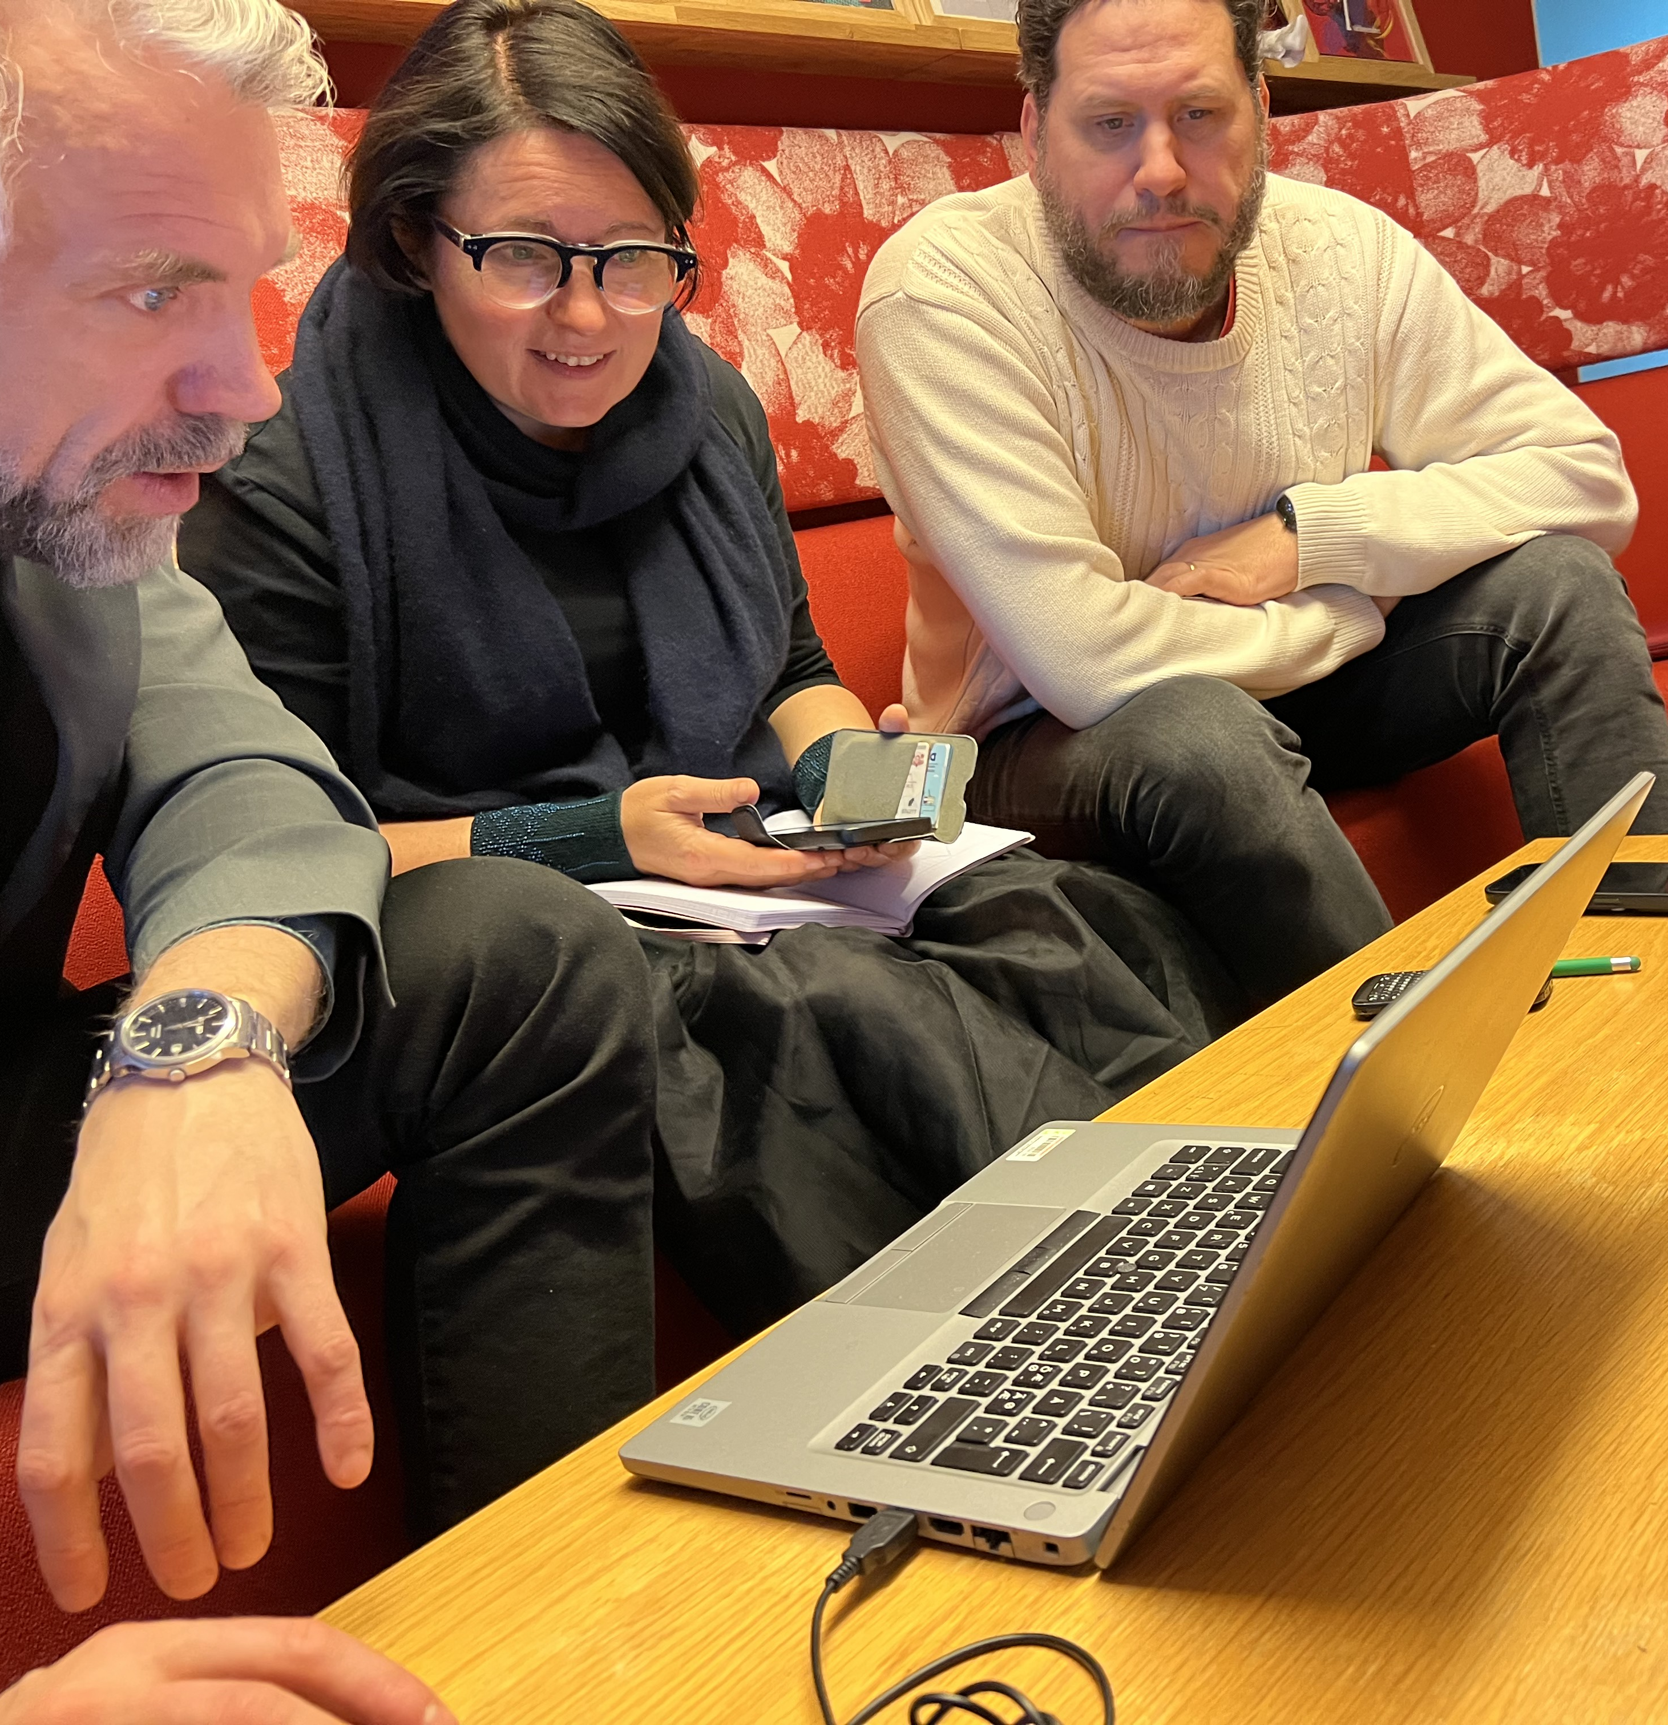
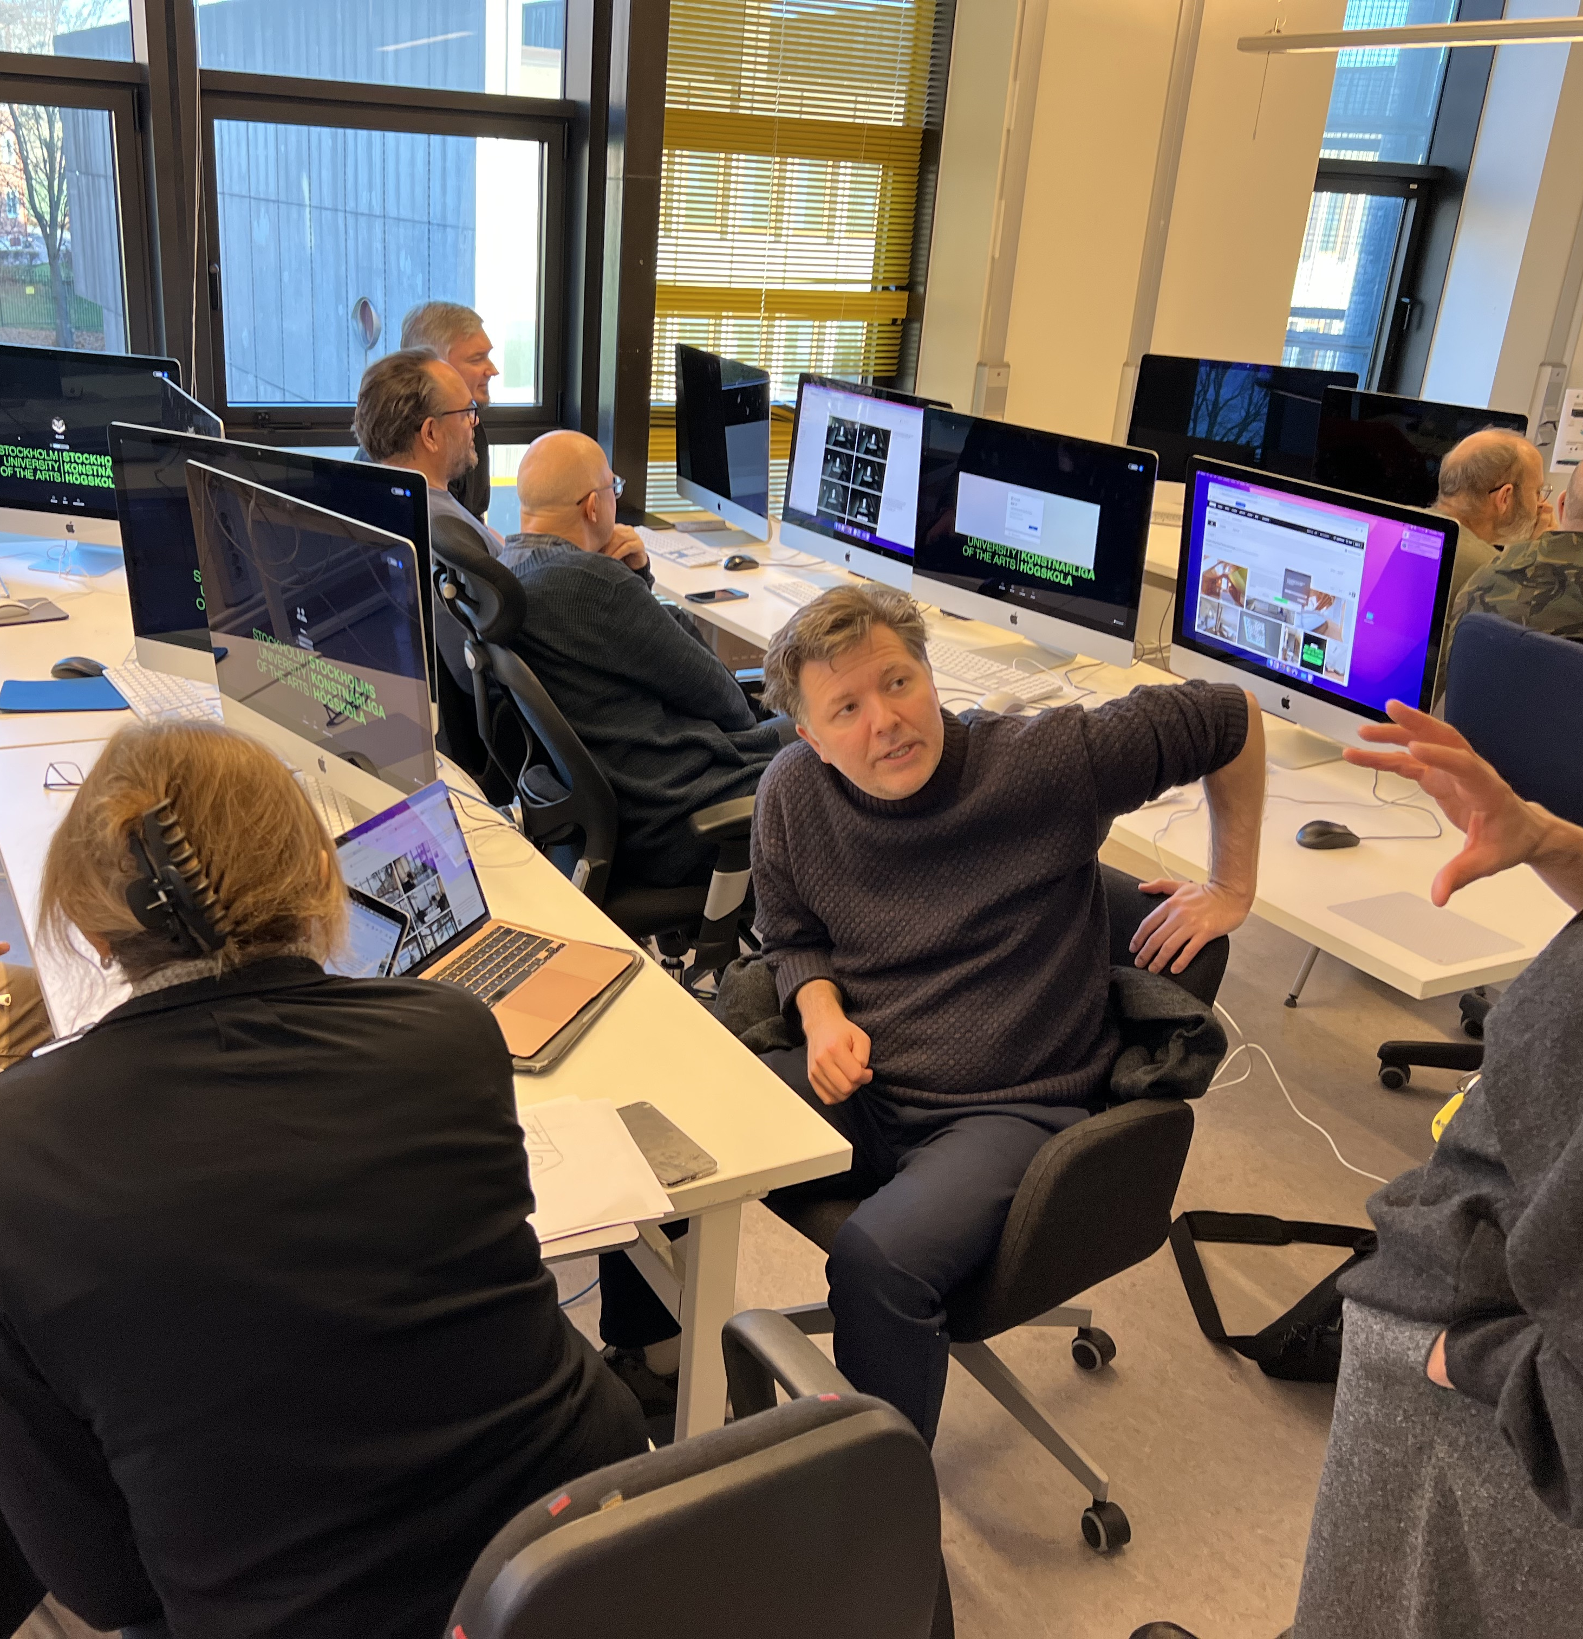
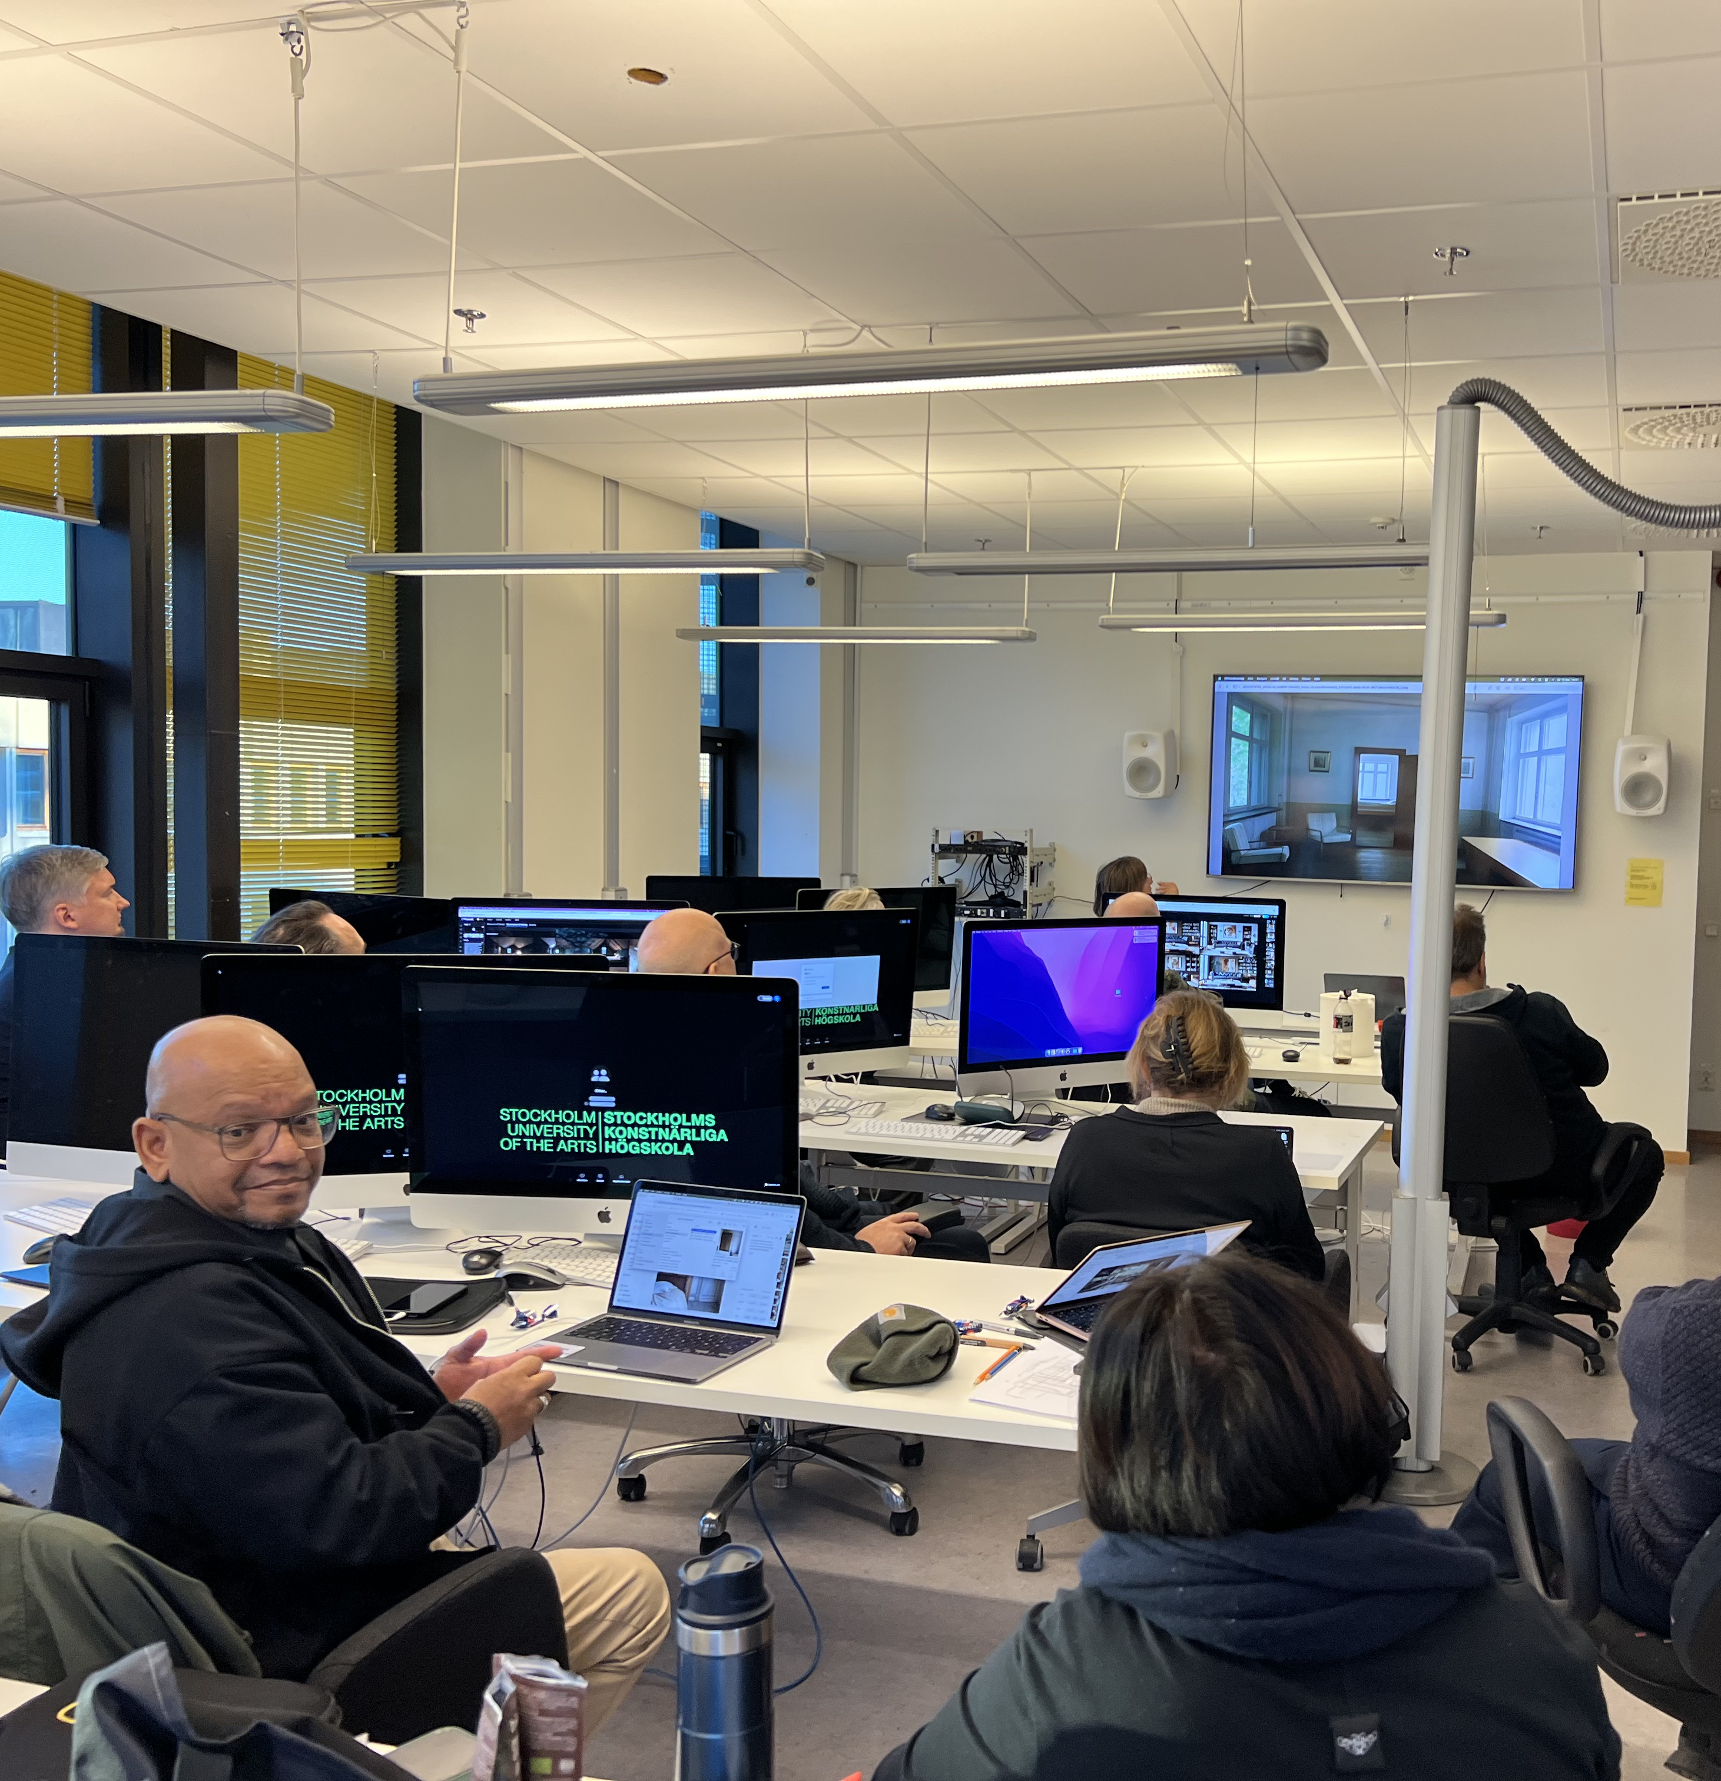
Artificial Intelligence in Media Production teacher’s workshop
Stockholm, December, 2024
Notes:
In December, 2024, as part of the course, Introduction to AI tools in Media Production, 10 teachers from the Nordic/Baltic region were invited to Stockholm to participate in a 5 day workshop focusing on AI tools in the classroom. This workshop was organized and funded through our NordFilm network of schools.

Slide 49

Support International Student and Faculty Recruitment
Notes:
Here’s a simple one
Promote diversity by attracting international talent, enriching the educational environment for all.

Slide 50

Small steps
Trial and error and retrial
Notes:
Encourage the smallest of steps.
Expect teacher’s to try
And to trial and to error and to retryal

Slide 51

Continung the Discussion
Notes:
Provide consistent updates, host discussions, workshops, and brainstorming sessions where faculty can explore and co-develop internationalisation strategies tailored to their teaching and research.

Slide 52
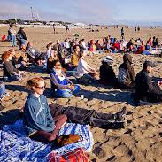
Closing
Notes:
Let’s pull our heads out of the sand — and help others to lift their heads
and look outward together.
Let’s lead the change for a globally engaged film/media education at our home institutions
Engage with your fellow educators while you are here
Begin the dialogue toward a possible future workshop exchange, a visiting seminar, a CILECT pilot project, or across time zones in the online classroom.

Slide 53
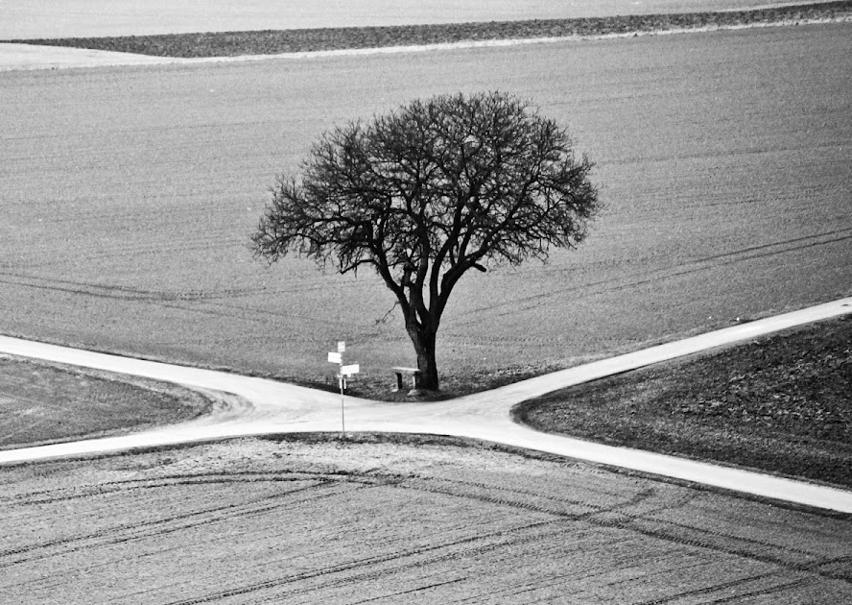
“You, teacher, dwell at the crossroads of people, places, institutions, and more. There are no perfect boundaires there that rule out the manifold expressions of human nature – remembering, too, that that very nature is ever-changing in ways nobody can mark or calculate, since we are all too close to see it”.
Hansen, David T. (2011), p. 107.
Notes:
And I would leave you with these two quotes from education researcher, David T. Hansen
“You, teacher, dwell at the crossroads of people, places, institutions, and more.
There are no perfect boundaires there that rule out the manifold expressions of human nature –
remembering, too, that-that very nature is ever-changing in ways nobody can mark or calculate, since we are all too close to see it”.

Slide 54

“Socialization makes it possible to be critical in the first place …”
Hansen, David T. (2011), p. 93.
Notes:
And a final reminder, as it relates to this symposium itself, and to any and all efforts to introduce your students, teachers, and staff to develop a fuller understanding of the wider world we live in.
“Socialization makes it possible to be critical in the first place …”

Slide 55

Thank you

