Slide 1
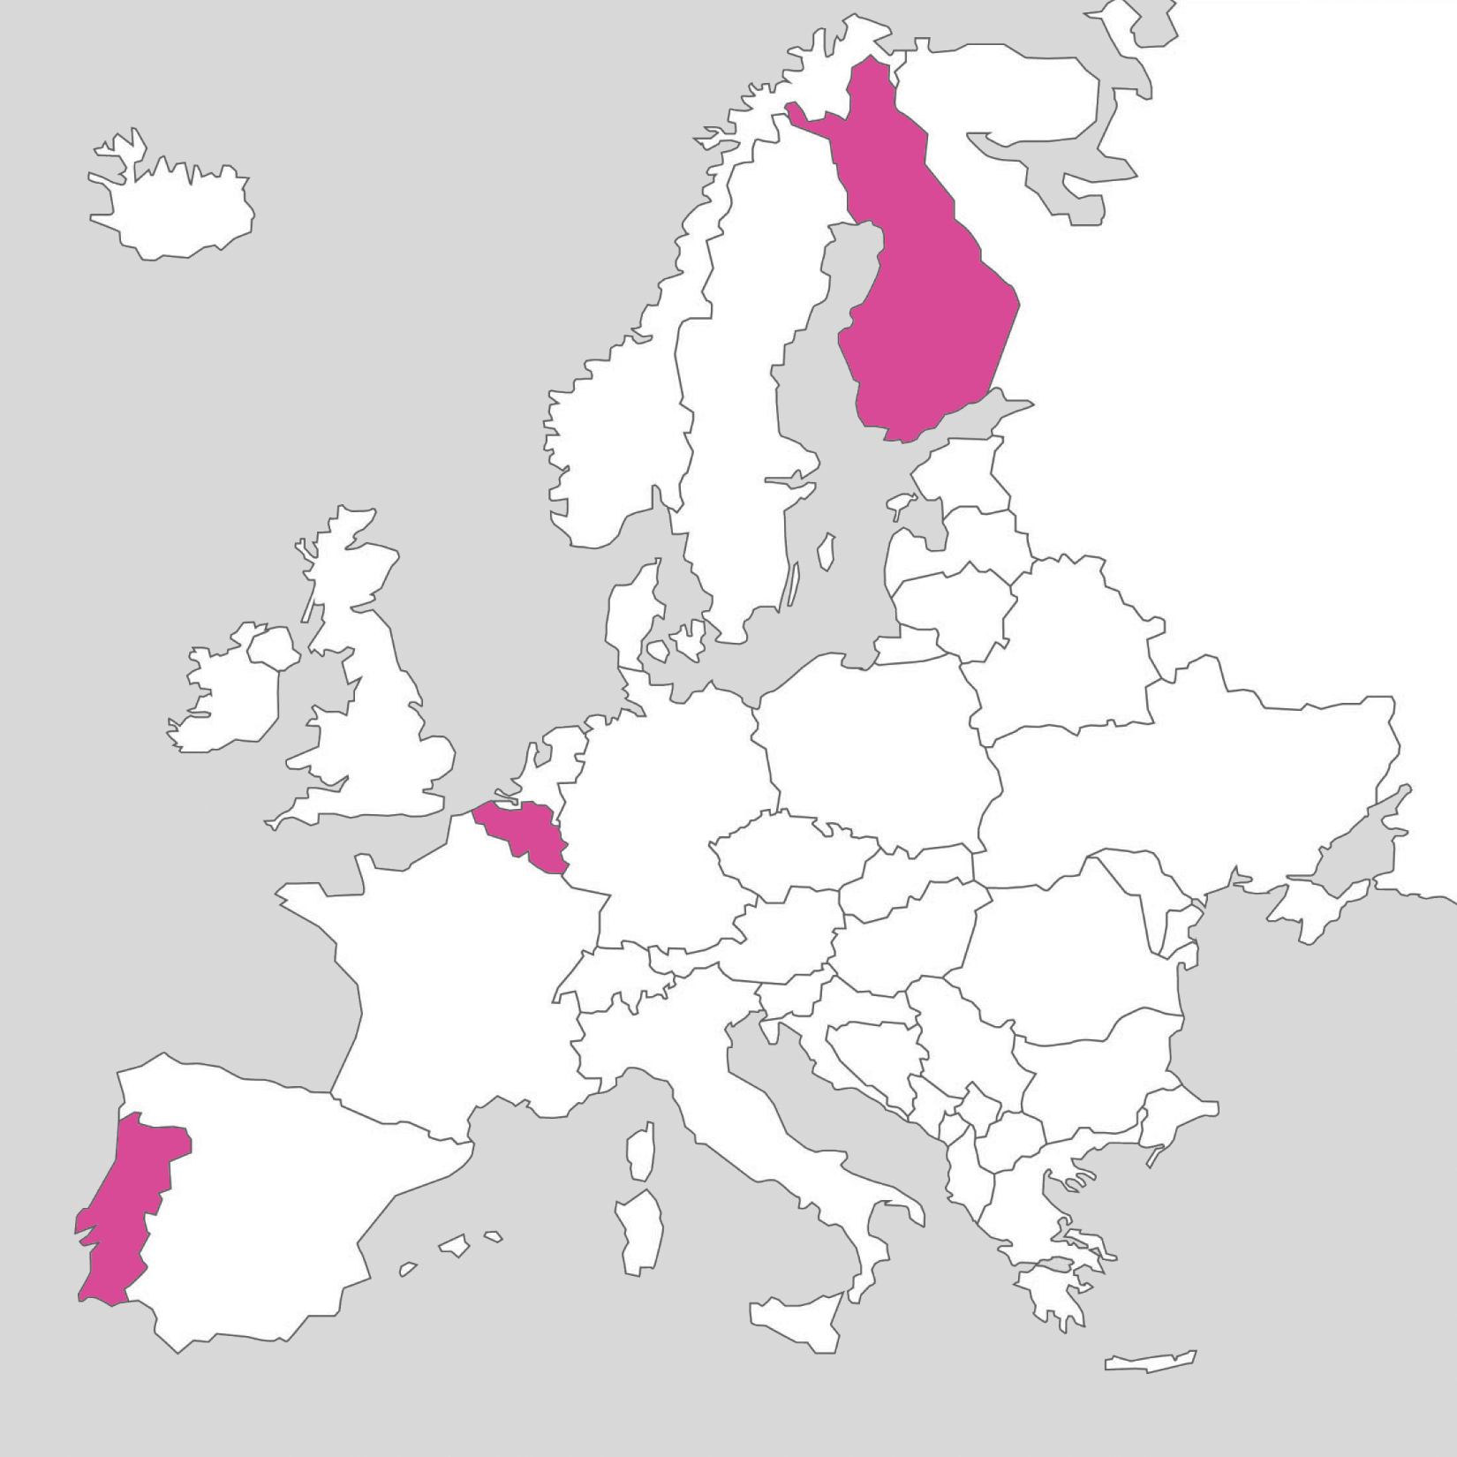




Slide 2
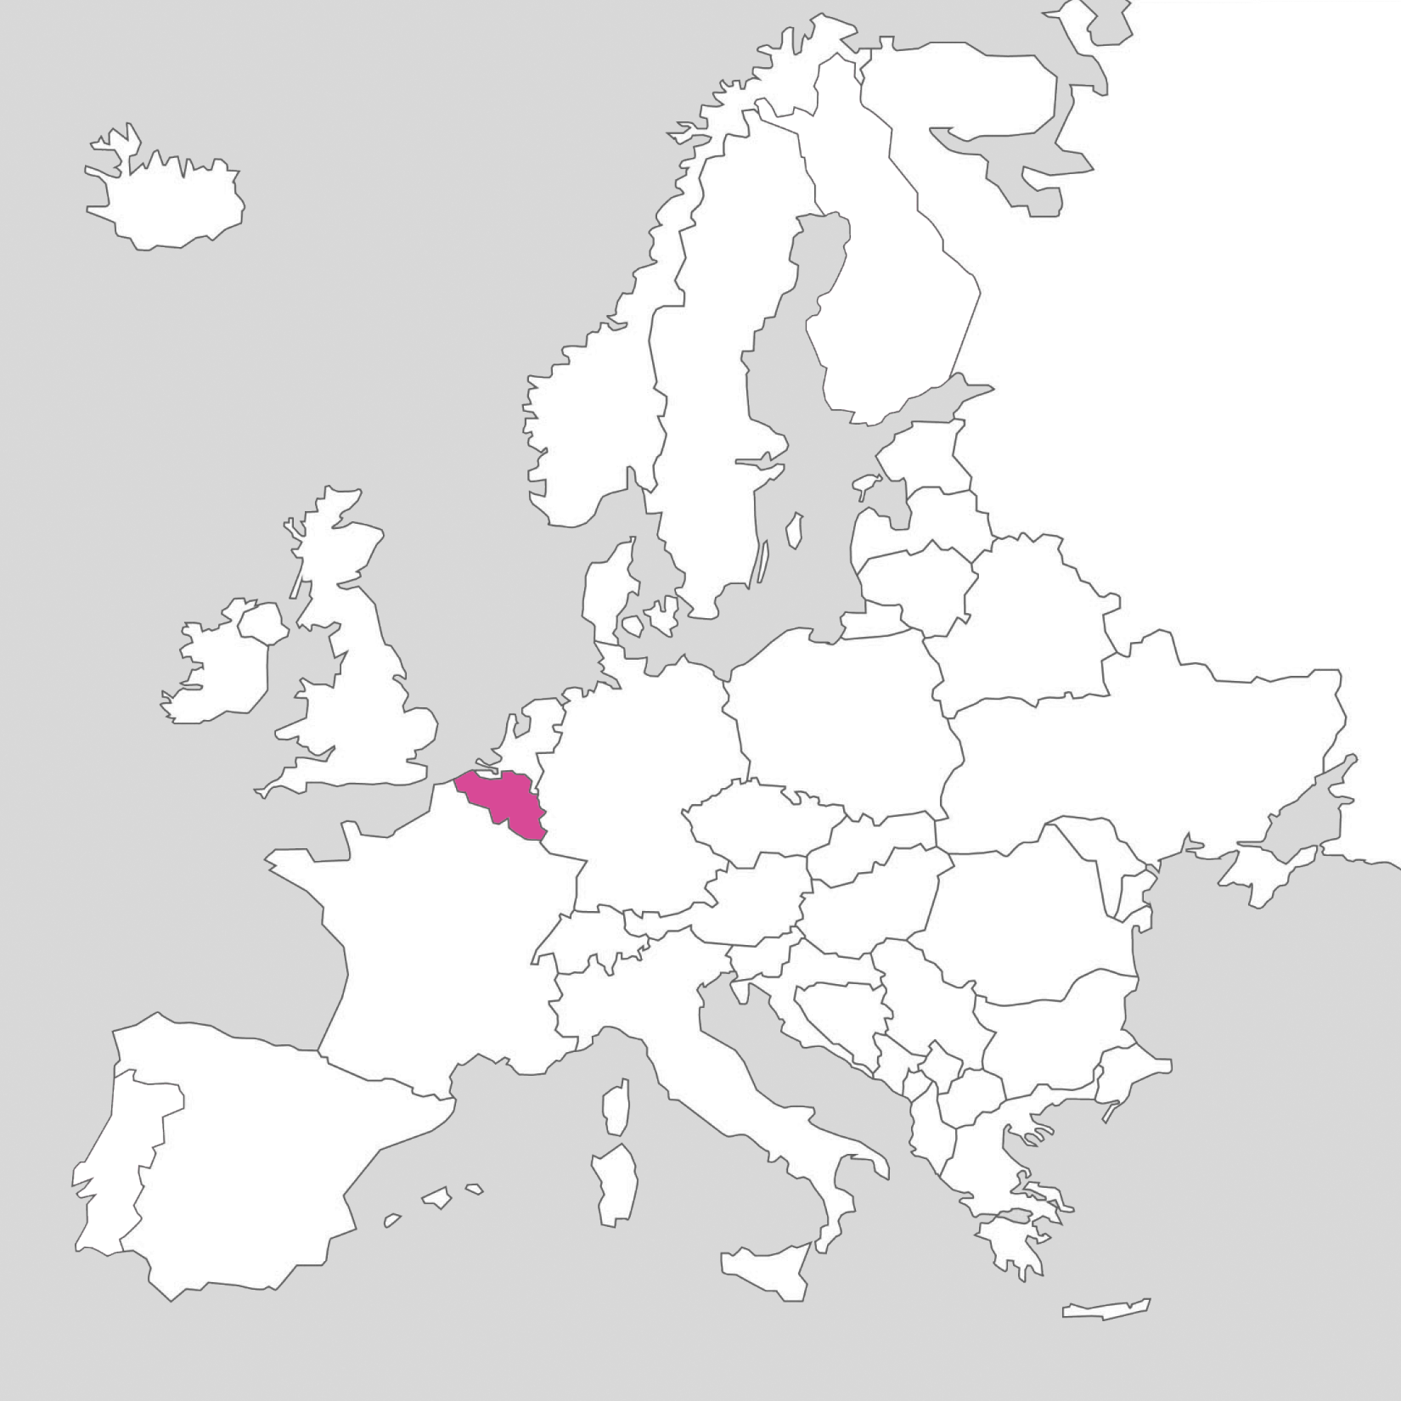
SEMESTER 1
RE:SEARCH IN ANIMATION

Slide 3
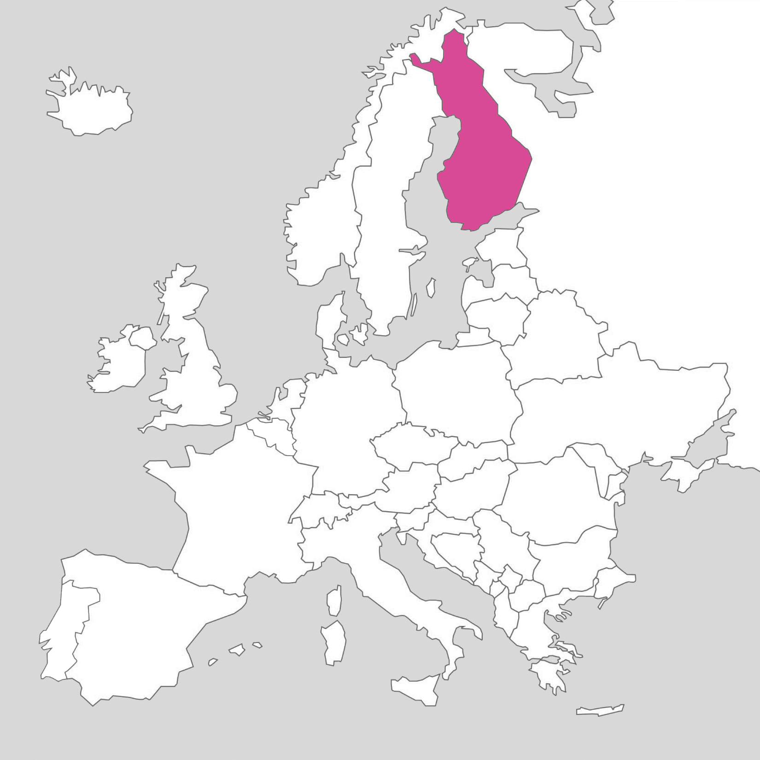
SEMESTER 2
RE:MEDIATION OF ANIMATION

Slide 4
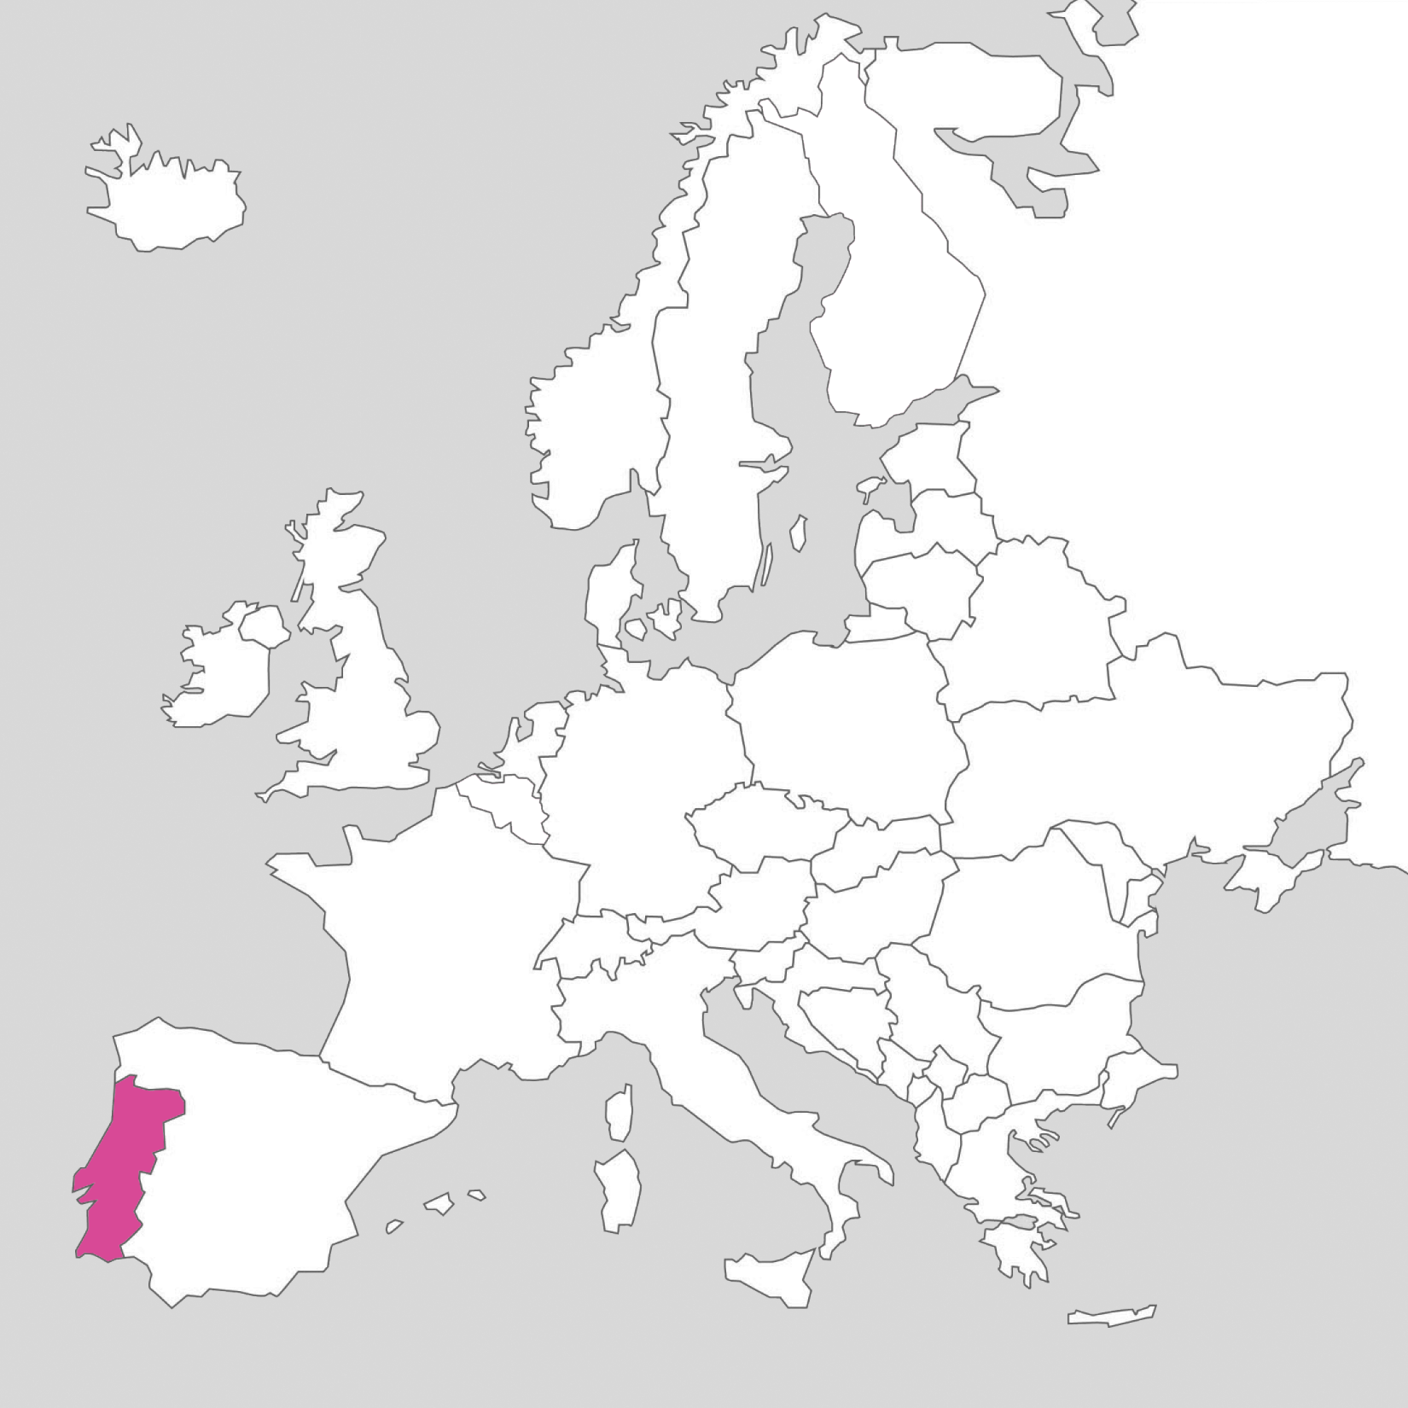
SEMESTER 3
RE:FLECTION THROUGH ANIMATION

Slide 5
SOME NUMBERS
Countries represented
Annual intakes, starting 2021.
First intake graduated in June 2023.
4 intakes, 75 students, coming from 22 countries (Africa, Asia, Europe and Latin America)
64% self-declared female students, 36% male.
Average age when starting: 28,7 years
Age range: from 22 to 43 years
Bangladesh
Brazil
Colombia
France/Vietnam
Georgia
Ghana
Indonesia
Iran
Italy
Kenya
Lebanon
Mexico
Montenegro
Nigeria
North-Macedonia
Pakistan
Panama
Peru
Portugal
Russia
Scotland/Netherlands, The
Sweden
Taiwan
Thailand
Turkey
Uganda

Slide 6
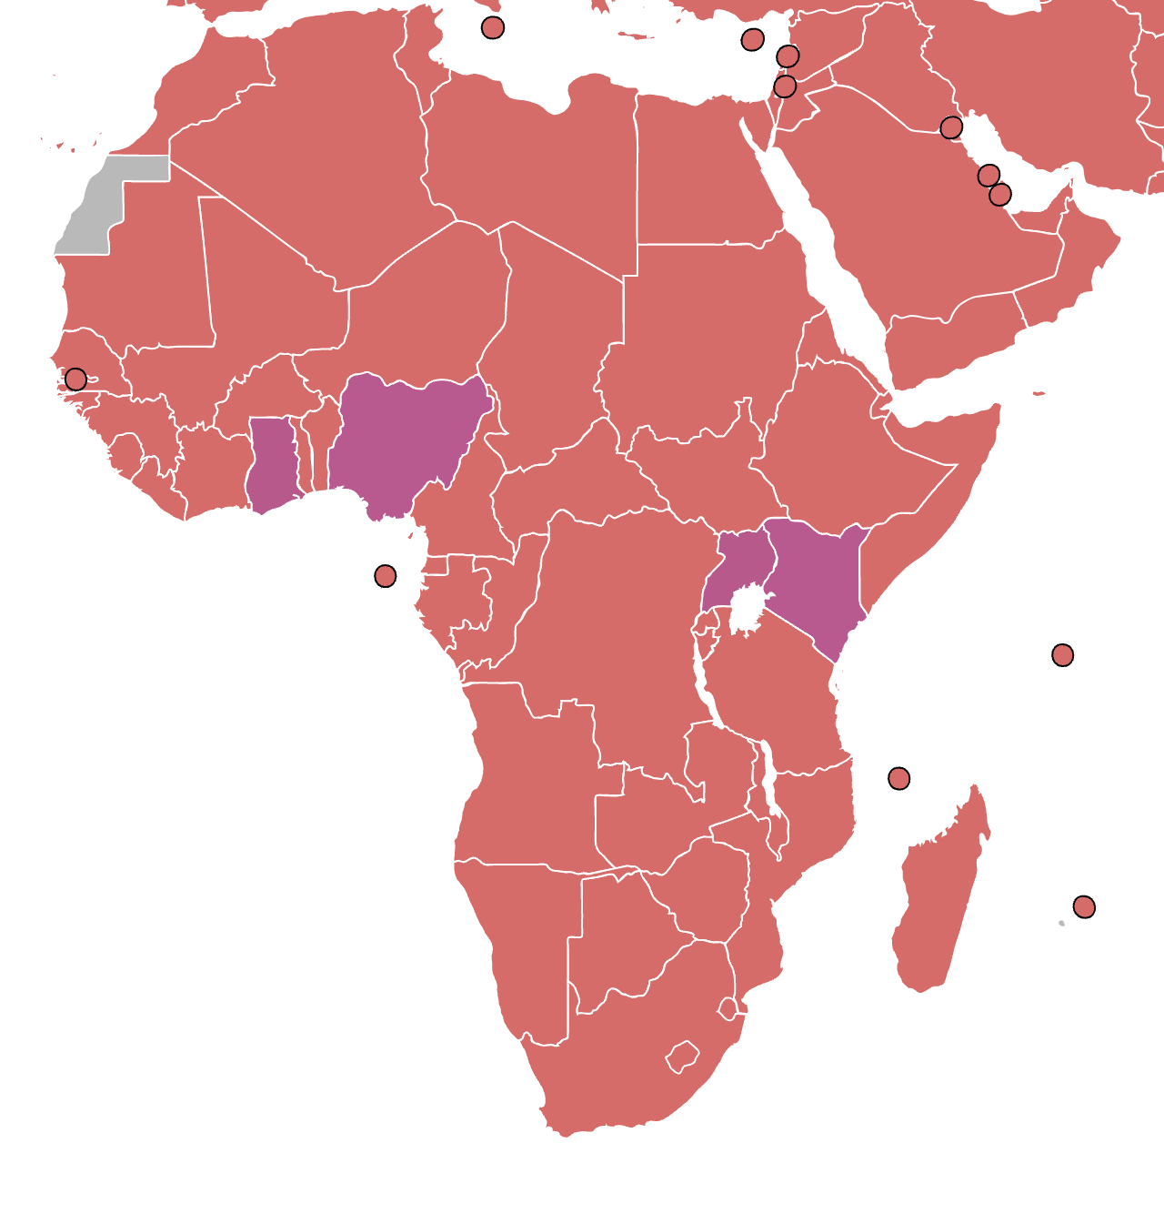

Slide 7
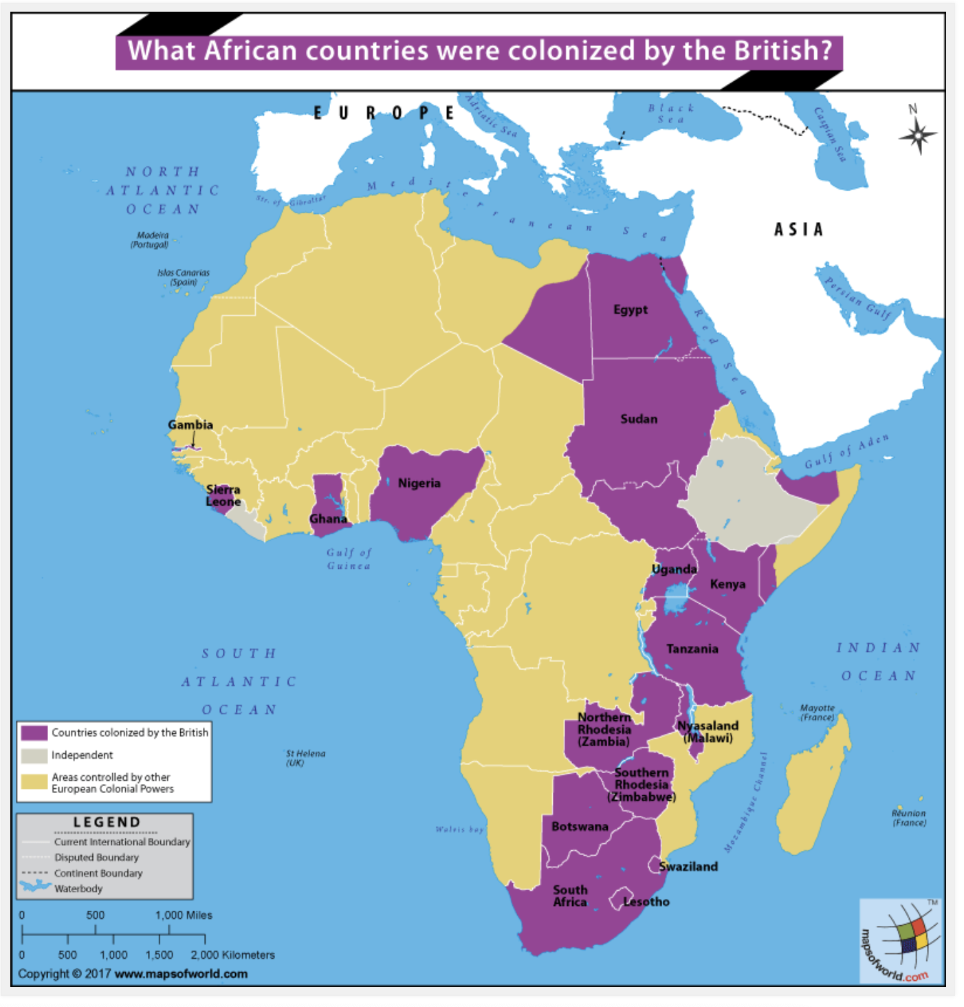

Slide 8
“Language carries culture, and culture carries, particularly through orature and literature, the entire body of values by which we come to perceive ourselves and our place in the world.”
Decolonising the Mind (1986), Ngũgĩ wa Thiong’o

